Slide 1
Writing Approvable CFP Investments & Scopes of Work
April 16, 2020

Slide 2

Technology Stuff
Please mute your microphone
Please turn off your web cam
Ask questions in the chat function
Sessions will be recorded and posted

Slide 3
Future Sessions and Resources
A link to the Session List/Virtual Conference Information document is embedded in the you received on April 9.
This document, as well as resources, templates and guidance referenced during sessions, can be found on the AOE website:
  Go to education.vermont.gov
  In the left-hand sidebar, click on
    “Student Support”
    “Federal Programs Under ESSA”
    “Consolidated Federal Programs”

Slide 4
Important Documents
Reference Documents
Writing Approvable CFP Investments
Schoolwide Program Requirements
Allowable Use Documents
Title IA
Title IIA
Title IIIA
Title IVA
McKinney-Vento
Administration
Parent & Family Engagement
Templates
Scope of Work Template
Data Inventory
All CFP documents, including those listed here, can be found on the CFP webpage

Slide 5
Introduction

Slide 6
What is a CFP Investment?
CFP Investments are statements made by the LEA that describe, in detail, their intended strategies for utilizing CFP funds for addressing needs and problems.

Slide 7
What Purpose Does a CFP Investment Serve?
CFP Investments…
Identify a data-supported need
Identify strategies and/or activities to address the need
Help the CFP Team determine approvability of the Investment

Slide 8
Approvability

Slide 9
What Determines Approvability?
When the CFP Team examines an investment, they ask:
Is this investment reasonable?
Is this investment necessary?
Is this investment allowable?
Is this investment allocable?
Another important consideration…
Supplement not supplant

Slide 10
Reasonable
What is reasonable is defined by the Code of Federal Regulations (CFR) in 2 CFR §200.404*:
“A cost is reasonable if, in its nature and amount, it does not exceed that which would be incurred by a prudent person under the circumstances prevailing at the time the decision was made to incur the cost.”
*The definition of “reasonable” can also be found in OMB Circular A-21

Slide 11
Reasonable: 2 CFR 200.404 Continued…
In determining reasonableness of a given cost, consideration must be given to:
(a) Whether the cost is of a type generally recognized as ordinary and necessary for the operation of the non-Federal entity or the proper and efficient performance of the Federal award.
(b) The restraints or requirements imposed by such factors as: sound business practices; arm's-length bargaining; Federal, state, local, tribal, and other laws and regulations; and terms and conditions of the Federal award.
(c) Market prices for comparable goods or services for the geographic area.
(d) Whether the individuals concerned acted with prudence in the circumstances considering their responsibilities to the non-Federal entity, its employees, where applicable its students or membership, the public at large, and the Federal Government.
(e) Whether the non-Federal entity significantly deviates from its established practices and policies regarding the incurrence of costs, which may unjustifiably increase the Federal award's cost.

Slide 12
Details, Details, Details…
Details are very important in determining if an investment is reasonable.
If an investment is overly vague and lacks the details necessary to determine if it is reasonable, it will get returned and more information will be requested.
Keep in mind that the CFP Team only has the information you have provided in the Investment Description and attached documentation.
Plan ahead to the extent that it is feasible as placeholders are NOT allowable anywhere on your CFP Application. Typically, “TBD” shouldn’t appear in your investments.
Do NOT assume we know anything about your Investment strategies or activities.

Slide 13
What Information Helps?
Context is very important in determining whether or not an Investment can be considered to be “reasonable.”
How many individuals will participate in a PD activity?
  2 people vs. 25 people
What supplies are being purchased?
  25 copies of Jim Knight’s Impact Cycle to accompany coaching PD vs. Flip charts
Where is a conference being held, if asking for travel costs?
  Travel to and from Albuquerque, NM vs. Travel to and from Stowe, VT

Slide 14
Example: Overly Vague
“To provide high quality academic instruction, TBD provide training for supporting students who are struggling.”
What is missing to determine if this is reasonable?
Training is defined as “TBD”
  While procurement guidelines must be followed, you should have a rough idea of the PD you are asking for funding for. Otherwise, this is a placeholder.
“To provide high quality academic instruction” does not necessarily define a need. All schools should be trying to provide high quality instruction.
  Tie this to your data. Is there a particular academic area that has data supporting a need for improvement in instruction? What is the end goal? i.e. “To improve instructional practices in order to increase proficiency levels on math assessments…”
How many teachers will participate in this training?
How long is the training? Will this be a one day training, a series, job-embedded, etc.?

Slide 15
Let’s Fix It!
Example 1:
“To provide high quality academic instruction, TBD provide training for supporting students who are struggling.”
“To improve instructional practices in order to increase proficiency levels on math assessments, provide 4 half-day trainings during in-service days for up to 15 math teachers.”

Slide 16


Reasonableness Outside of CFP
Still frustrated by what is reasonable or not? That’s okay!
Suppose I asked you for $50 for ice cream…is that reasonable? That depends…
$50 for ice cream for one person
$50 for ice cream for 20 people
Details and context are important!

Slide 17
Necessary
What is necessary is based on the data you have.
If you think your LEA needs something, ask yourself:
How do you know you need it?
Data – Quantitative and Qualitative
  Assessments
  Behavior referrals
  Teacher evaluations
  Surveys
    Staff members
    Students
    Parents

Slide 18
Fear Not Your Data!
It can be difficult for even the most data-savvy person to organize many different types of data from many different sources and platforms into a usable format.
Data Inventory
Not intended to be a narrative or a “final product” but a tool
A “dumping ground” for all of your data to help you look at the big picture
Remember that the CFP Application takes a village!
Communicate with the folks who manage the data at your LEAs and let them help you.

Slide 19
Want vs. Need
Broken record:
Remember when you are planning your CFP Investments that their necessity must be backed up by data.
WANT
Wouldn’t it be nice to…
OR
We would like to…
We need to…
OR
We must…
NEED
VS
Investments NOT supported by data CANNOT be approved.

Slide 20
Allowable
The term “allowable” refers whether or not a particular strategy or activity is permissible based on statute; the statutes that determine allowability for Title programs can be found within the Elementary and Secondary Education Act of 1965, reauthorized as the Every Student Succeeds Act in December 2015.
In addition to statute, the Department of Education has created Non-Regulatory Guidance documents for each of the Titles.

Slide 21
Allowable Uses
While some Investments may meet the intents and allowability of more than one Title, each Title program (IA, IIA, IIIA & IVA) has its own intents and allowable uses.
Vermont’s “Allowable Use” documents are available on the CFP website for:
Title IA
Title IIA
Title IIIA
Title IVA
McKinney-Vento
Administration
Parent & Family Engagement
If you have a question about the allowability of an Investment, reach out the CFP Team ☺

Slide 22
Allocable
According to EDGAR/CFR, a cost is allocable to a federal award if the goods or services involved are chargeable or assignable to the federal award or cost objective in accordance with the relative benefit received.
An important aspect of allocability is that the particular investment is necessary to the overall operation of the non-federal entity (in this case, your LEA) and without these funds the services, activities, etc. would not occur.

Slide 23
Allocable
Costs can, and should, be distributed in proportions if it benefits both the Federal award and other work of the non-federal entity
For example if you have an individual who is 1.0 FTE interventionist, who is paid .5 by a Federal award and .5 by local funds
This means that 50% of this individual’s time must be spent on activities related to the intents of the Title or funding source being charged
If you need to purchase this individual a computer, only 50% of the cost of the computer can be allocated to the Federal award
Say the same individual needed supplies/materials to do the interventions, allocable would be 50% paid by the Federal source of funds and 50% by local funds
Basically the grant can only pay for the portion that benefits the intentions of the funding source.

Slide 24
Scopes of Work

Slide 25
What IS a Scope of Work?
A Scope of Work, for the purposes of the CFP Application process, is a document that provides a detailed account of an Investment to assist with justifying its approvability.
According to the “Writing Approvable CFP Investments” document, it must contain the following information:
Why the activity is necessary
The timeline for the specific activities/deliverables
The costs associated with the project activities
Rationale for exceeding fair market price
The process by which the service outcomes will be measured, or more simply…how will you know that your intervention was successful?

Slide 26
When is a Scope of Work Needed?
For the CFP Application, you could be asked to produce a Scope of Work for any Investment in order to determine if it meets the 4 criteria of:
Reasonable
Necessary
Allowable
Allocable
However, a Scope of Work is mandatory for any Investment that exceeds “Fair Market Value” for the particular strategy or activity in the State of Vermont.

Slide 27
When is a Scope of Work Needed (cont.)
Most commonly, a Scope of Work will be required to justify consultant fees that exceed the Fair Market Value as defined in the CFP Document “Writing Approvable CFP Investments,” though it may be required for any other Investments who cost requires justification.
If you are attaching a Scope of Work or any other documentation to support an investment, you must include “Supporting documentation attached” within the Investment Description.

Slide 28
Fair Market Value
According to EDGAR, Fair Market Value is defined as “market prices for comparable goods or services in the geographic area.”
The market price for external consultants in Vermont shows a range of $350.00 to $2000.00 per day. Please note that the total for consultant fees must reflect all related expenses, including:
Materials
Travel
If you know that your consultant fees do NOT exceed the Fair Market Value, it is helpful for the CFP Team if your Investment Description contains “not to exceed $2,000/day” so it is clear that a Scope of Work is not necessary.

Slide 29

So You Need a Scope of Work…Now What?
If a member of the CFP Team asks you for a Scope of Work, you might be feeling:
Frustrated
Confused
Overwhelmed
Like you don’t have time for this!!

Slide 30
Scope of Work Template
We know that you are busy and wearing many hats, so we have developed an optional Scope of Work Template to make sure that we get all of the necessary information the first time.
Using this template in its entirety should minimize returned applications for missing/additional information. Providing only some of the information requested it likely to result in your application getting sent back to you.
Trust us, we do not like returning applications any more than you like getting them back…so let’s take a look at the Scope of Work Template.

Slide 31
How to Use the Scope of Work Template
The Scope of Work Template is intended to be completed electronically, saved and uploaded to your CFP Application.
Though it is available as a Microsoft Word Document, we recognize that many schools are Google schools, and it is easily utilized in Google Docs too. If you are uploading Google Docs files or linking to Google Docs within your Scope of Work, please note that we will be unable to open Google Docs per AOE policy.
When uploading any documentation to your CFP Application, please name uploaded files to clearly identify the investment they are supporting
(i.e. Investment 25 – Scope of Work.docx)
This will allow us to easily identify what Investment the documentation belongs to, and will speed up the application review process.

Slide 32
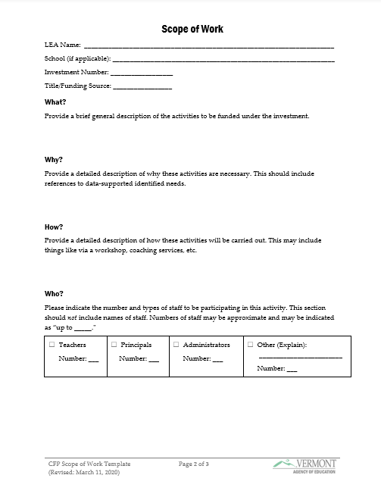
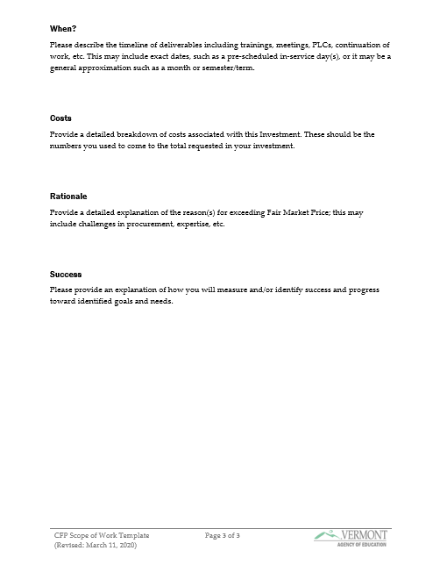
The Template

Slide 33
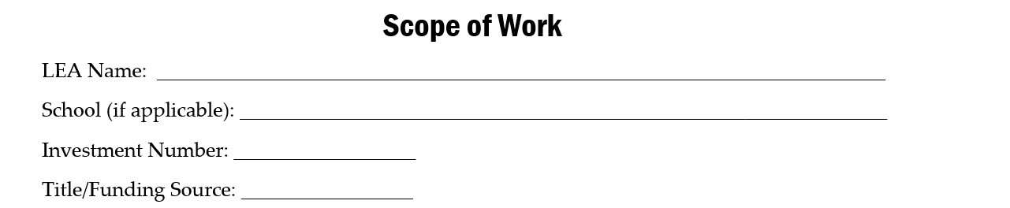
Walking Through the Scope of Work Template
1
2
3
4
Self-explanatory ☺
If the Investment is tied to a particular school, indicate that here. Otherwise, leave this blank.
The number for the Investment on the CFP Application itself
What Title or Funding Source you are proposing to use

Slide 34
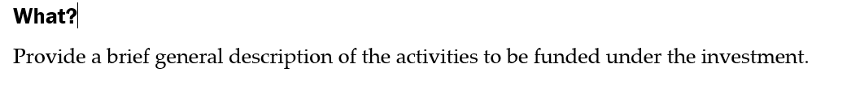
Template: What?
Describe for us what you’re proposing to do with this Investment.
This can be just 1-2 sentences as this is NOT where you will go into detail about how you’re going to carry out the Investment activities…you’ll give that to us later in the document.

Slide 35
Template: What? - Examples
Below are some examples of how you might answer the “What?” of the Scope of Work Template:
“LEA-wide training for all K-12 teachers in Developmental Designs.”
“Consultant to provide content-area specific training to teaching teams on MTSS.”
“Training for 9-12 teachers on the creation and use of assessments.”
“Consultant to work with Leadership Team and assist with the development of meaningful evaluation and feedback systems for teachers.”
As you see, these can, and should, be very brief and simple.

Slide 36
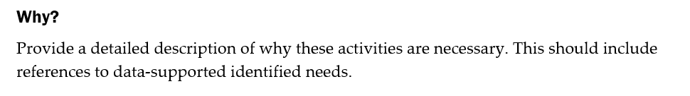
Template: Why?
This is where you will provide an explanation of why you feel that this particular strategy or activity is needed.
You should include specific references to data that supports this Investment as being necessary. If you do not have data that backs up the need for the Investment, it is likely not approvable.

Slide 37
Template: Why? – Example 1
Below is one example of how you might answer the “Why?” of the Scope of Work Template:
“Behavior referral data shows an sharp increase in behavior referrals over the last 2 years, which we believe indicates that our current model of PBIS is not sufficient to address the complex academic and social-emotional needs of students. After much research, it was decided that Developmental Designs would be the best fit for addressing this need.”

Slide 38
Template: Why? – Example 2
Below is another example of how you might answer the “Why?” of the Scope of Work Template:
“Teacher surveys have indicated that our current evaluation and feedback systems for educator performance are not sufficient to promote ongoing professional growth. The Leadership Team has identified a need for a modernized evaluation system that provides ongoing monitoring of and feedback on educator performance, rather than the current model of biannual observations and one annual performance evaluation.”

Slide 39
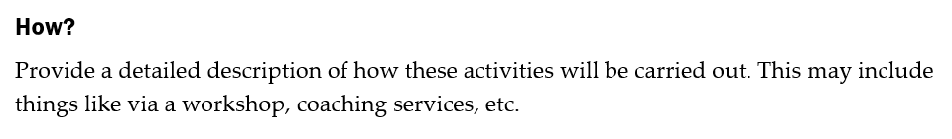
Template: How?
This is where you will describe to the CFP Team how you plan to carry out the strategy or activity.
If your Investment involves a combination of methods of delivery, such as a blend of in-person workshops and virtual coaching, you will indicate that here.

Slide 40
Template: How? – Example 1
Below is an example of how you might answer the “How?” of the Scope of Work Template:
“A consultant will provide two in-person full-day workshops on Developmental Designs to the K-12 teaching staff, along with monthly virtual meetings to each grade level, for elementary teachers, and to content-specific teams for middle and high school teachers to assist with ongoing planning, monitoring and support.”

Slide 41
Template: How? – Example 2
Below is another example of how you might answer the “How?” of the Scope of Work Template:
“Leadership Team will receive 4 full days of planning and development consulting from an expert in teacher evaluation and feedback systems, and 2 virtual follow-up sessions to reflect on implementation and assist with making changes to evaluation model based on initial feedback and identified needs of teachers.”

Slide 42
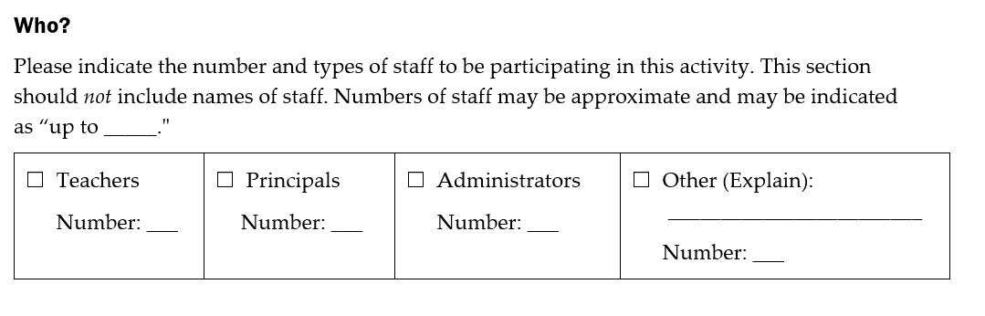
Template: Who?
In this section, you will check the corresponding box for the type of staff who will be participating in the strategy/activity, and the number of that type of staff expected to participate. When in doubt, err on the side of more participants than less to prevent disallowed costs.

Slide 43
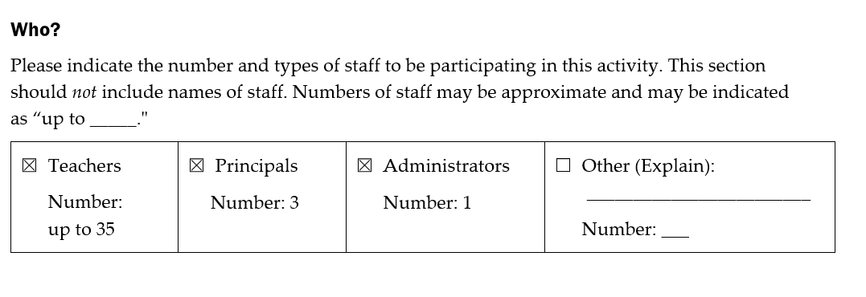
Template: Who? - Example
Below is an example of what the “Who” section may look like after you’ve completed it:

Slide 44
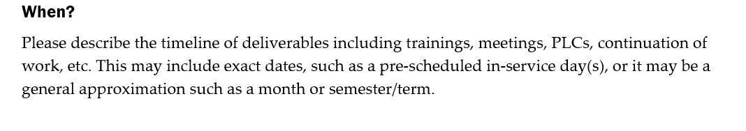
Template: When?
In this section, you will provide a more in-depth explanation of the timeline of the activities described in the “How?” section of the Template.
We recognize that the CFP Application process often takes place before full planning of the strategy/activity may have taken place. Please give your best approximation of the implementation, and consult with individuals and/or Teams involved in the planning of the Investment as needed.

Slide 45
Template: When? - Examples
You may complete the “When?” section of the Template as a narrative, or with a table.
A narrative might look like:
This Investment will involve one in-person full-day workshop on a pre-service day in August and one in-person full-day workshop on January in-service day. To continue ongoing job-embedded professional learning, each grade level (for elementary schools) or each content area (for middle and high schools) will receive one two-hour virtual meeting with the consultant after school each month.
4 full days of workshop sessions with consultant during August pre-service, and 2 2-hour follow-up sessions with consultant and Leadership Team to take place in October and March.

Slide 46
Template: When? - Examples
A table might look like:
When | What | Who
August 2020 | In-person full-day workshop with consultant during pre-service | All K-12 teachers
January 2020 | In-person full-day workshop with consultant during in-service | All K-12 teachers
Monthly | 2-hour virtual meetings after school with consultant for a total of 8 meetings for each group | All K-12 divided into sub-groups: Elementary schools: Each grade level Middle and high schools: Each content area

Slide 47
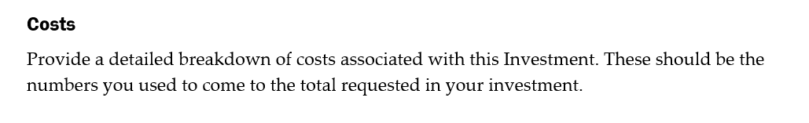
Template: Cost
The cost information provided on the Template should help the CFP Team understand how you got to the total amount requested for the Investment. As with the “When?”, we understand that the actual cost will often not be available at the time of the CFP Application. These figures can be approximated, but should be specific in order to provide information needed to determine approvability of the Investment.
DO:
Give the approximate costs for the various elements of the Investment
Show that the amount asked for is an accurate depiction of anticipated costs
DON’T:
Simply restate the total entered into the CFP Application
Direct CFP Team to the “Budget Details” page of the CFP Application

Slide 48
Template: Cost? - Examples
It is likely you will want to provide a table of some sort to explain the costs associated with your Investment, or copy and paste from an Excel sheet. It might look like:
Description | Cost
Consultant Fees: Full-day in-person sessions @ $3,000 (2 total) Includes time, travel, and materials | $6,000.00
Consultant Fees: 2-hour virtual sessions @ $100 each (8 sessions x 10 groups for a total of 80 sessions) | $8,000.00
Materials: Teaching for Equity Book @ $19.95 (35 copies) Developmental Designs Self-Coaching Guide @ $24.95 (35 copies) Shipping & Handling @ 18% | $1,854.37
TOTAL: | $15,854.37

Slide 49
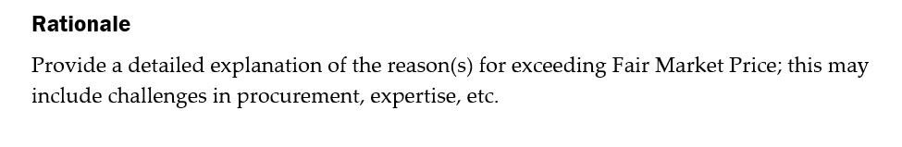
Template: Rationale
Here is where you will plead your case for why you are exceeding Fair Market Price, and why doing so is necessary. You may describe the process by which you explored options and costs, etc.

Slide 50
Template: Rationale - Examples
Some examples of rationale for exceeding Fair Market Value might be:
The desired consultant offers workshops out-of-state but travel costs exceeded the cost to bring consultant to the LEA
Consultant is a well-renowned content-area expert
No comparable consultants available locally
Continuation of consulting work from previous year(s) that exceeded FMV

Slide 51
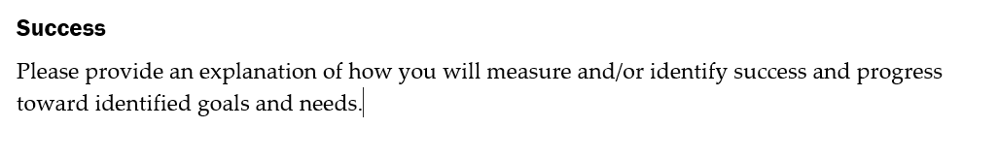
Template: Success
Simply put, this will be a brief description of how you will know that your strategy/activity was successful in accomplishing what you had set out for.

Slide 52
Template: Success - Examples
Some examples of measurements of success might be:
10% decrease in behavior referrals as measured by SWIS data
All students reaching proficiency in math based on SBAC scores
Increase in staff satisfaction with the amount and frequency of feedback based on staff survey results
Development of an evaluation system that encourages personalized professional learning planning and professional growth

Slide 53
But I Don’t Want to Complete MORE Paperwork!
While providing a Scope of Work is mandatory for investments that exceed Fair Market Value (or when requested by a CFP Team Member to determine approvability of an investment), the use of the Scope of Work Template is optional and intended as a tool to help you provide us the necessary information.
If you are providing another format of a Scope of Work, it must contain all of the same information requested on the Scope of Work Template and it must be all within one document.
Simply uploading a course/workshop description, printouts of information from websites, etc. or uploading multiple attachments will not be accepted.

Slide 54
Wrapping Up

Slide 55


Approvability At-a-Glance
Remember that in order to be approvable, the CFP Team must be able to determine that the investment is:
Reasonable
Necessary
Allowable
Allocable

Slide 56
Scopes of Work At-a-Glance
Scopes of Work are mandatory for any investment that exceeds Fair Market Value
  $2,000/day for consultants
A Scope of Work may be requested by a CFP Team Member if additional information is needed about your investment
You may use the provided Scope of Work Template or another document for your Scope of Work
  Must be uploaded to the CFP Application and given a file name that clearly indicates which investment it belongs to – i.e. “Investment 25 – Scope of Work.docx”
  If not using the Scope of Work Template, remember your submitted document must:
    Be a single document
    Contain all of the same information requested on the Template

Slide 57

Remember…
The CFP Team is here to help you – don’t be afraid to ask questions!
That is what we are here for!
Help us help you.
We like pressing the “Approve” button!

Slide 58

Questions

