Slide 1
Consolidated Federal Programs: What’s New?
April 5, 2021

Slide 2
Appreciation

Slide 3
Upcoming Sessions
Tuesday, 4/6, 10:00-11:30: Application Walkthrough (Karen)
Wednesday, 4/7, 10:00-11:00: Three Fiscal Tests of Title I (Kristine)
Thursday, 4/8, 10:00-11:00: Leveraging Title II (Megan)
Monday, 4/12, 10:00-11:00: CFP Monitoring (Karen)
Tuesday, 4/13, 10:00-11:00: Spending CFP Funds (Katy)
Wednesday, 4/14, 10:00-11:00: Addressing Application Feedback (Amber)

Slide 4
Topics
Data Inventory
FRL Data
Waiver Opportunities
Equitable Services
Writing Approvable Investments
Meeting Requirements: Schoolwide Planning
Meeting Requirements: Evaluating Title IV Investments
Covid
Questions?

Slide 5
Data Inventory
Each LEA is asked to submit a single Data Inventory, beginning FY22.
The Data Inventory is designed to meet needs assessment requirements under various ESEA Titles and to support the CFP application
The Data Inventory will be uploaded to the CFP application going forward, allowing for quick reference and revisions.

Slide 6
Data Inventory

Slide 7
Data Inventory
The Data Inventory is due when the original application is submitted. Applications can not be reviewed in the absence of an uploaded Data Inventory.
The CFP team will look to the Data Inventory when determining the necessity of individual investments.
LEAs will be able to revise and re-upload their Data Inventories as data becomes available, needs change or further information is requested.

Slide 8
Data Inventory
There is no separate review/approval process for Data Inventories—Data Inventories are expected to support the necessity of individual CFP investments, and revisions will only be requested in specific instances when a need has not been illustrated.
We do not intend to “police” the quality of measures or findings.
LEAs do not need to submit extensive raw data. Bulleted summaries and findings that support investments are acceptable. See examples.

Slide 9
FRL Data
You have choices in the data you use for Title I Targeting and Ranking (everyone chooses FRL).
FRL application collection was a challenge for some schools and LEAs this year due to extended federal summer meals programming.
You are invited to use previous (previous?) year’s FRL data (collected in October 2019, appears in your current CFP application) if the LEA decides that this more accurately represents true low-income rates

Slide 10
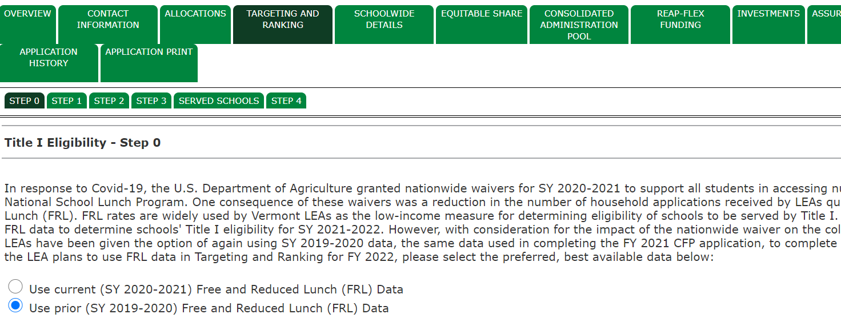
FRL Data

Slide 11
FRL Data
AOE’s data team has provided a lot of new guidance and TA around data collection, review and submission this past year.
They’ve also implemented new automated checks for submission errors and opened windows for resubmission, including the October 1 Census.
It is challenging to entertain revisions beyond resubmission windows, both from a technical standpoint and from a consistency standpoint.
Long story short, at the point you’ve receive your data from us, it can’t be updated.

Slide 12
Waiver Opportunities
FRL Data not what you expected? You have options.
Schoolwide Program Waiver:
Allows for Title I-eligible schools that do not meet the 40% low-income threshold to operate an SWP
Waivers are for three years (unless the school loses eligibility completely)
Narratives concerning SWP considerations and requirements to be submitted to Kristine Seipel

Slide 13
Waiver Opportunities
FRL Data not what you expected? You have options.
Title I Eligibility Waiver:
Allows for a school that is not eligible to be served by Title I to be promoted to eligible if its low-income rate is within 10% of a served school
Waivers are for one year.
Demonstration of eligibility and narratives to be submitted to Kristine Seipel

Slide 14
Waiver Opportunities
Title IV Spending Requirements Waiver
Statewide waiver requested.
Katy Preston will invite LEAs to apply individually using our EdFlex authority.
Removes the minimum spending requirements for LEAs with more than $30,000 in Title IV funds. HOWEVER, you still need to spend towards all three intents.
Elimination of the 15% cap on Technology Infrastructure spending within the Effective Use of Technology budget.

Slide 15
Equitable Services
Remember, each LEA receiving funds under ESEA is required to conduct outreach to eligible (non-profit, approved or recognized) independent schools
Needs to occur in the spring, before decisions about fund use or availability are made
Schools within the LEA’s boundaries—Titles I, II, III and IV
Schools beyond the LEA’s boundaries—Title I

Slide 16
Equitable Services
Still not sure how it works (particularly Title I)?
Presentation:
https://www.youtube.com/watch?v=Gijyk3xn9AI
Documentation of Consultation:
Documents outreach to and consultation with participating schools
Must use AOE form:
https://education.vermont.gov/documents/edu-cfp-equitable-services-documentation-of-consultation
Will be collected in GMS every fall—required under statute

Slide 17
Writing Approvable Investments
Statement of Purpose: Points to an assessed need or finding (D.I.)
In order to promote reading fluency…
In order to address an increase in chronic absenteeism…
In order to respond to staff needs around differentiating math instruction…
In order to support parent understanding of proficiency-based grading…
In order to provide additional science/STEM offerings…

Slide 18
Writing Approvable Investments
Activity/Strategy: Describes what will be funded, with enough details to establish reasonableness of budgeted costs, but avoiding specific names of products or providers.
…literacy interventionist to deliver small group instruction.
…home-school coordinator to focus on reengagement of students and families. Job description uploaded.
…6 to 8 classroom teachers to participate in monthly trainings provided by outside consultant, 1 to 2 hours each.
…high school staff will host two virtual parent information nights with content area presenters.
…contract with virtual provider for 50-75 student course slots.

Slide 19
Meeting Requirements

Slide 20
Schoolwide Planning
Title I Schoolwide Plans, revised annually, are required by statute—it’s important to know where/what your Schoolwide Plans are when audited or monitored.
In past years, including FY21, the Continuous Improvement Plan served as the Schoolwide Plan for SWP Schools, with an expectation that CIPs were drafted by school teams to meet all requirements under statute.

Slide 21
Schoolwide Planning
In FY21, the Data Inventory was added to make sure that the intents of all funds that required a needs assessment under statute were represented, supporting the CFP application. The Data Inventory is not, however, a Title I Schoolwide Plan.
In the coming months, guidance will be provided by the Title I team around the development of compliant Schoolwide Plans. This may include an AOE template for planning.

Slide 22
Evaluating Title IV Investments
An LEA’s Title IV application “must include program objectives and intended outcomes and describe how the LEA or its partners will periodically evaluate the effectiveness of program activities based on those objectives.” (ESEA section 4106(e)(1))
The CFP team is in the process of developing how to approach this requirement. This is may look like a required submission by the LEA.

Slide 23
Evaluating Title IV Investments
Furthermore…
Each State receiving Title IV, Part A funds must report on the degree to which local educational agencies (LEAs) have made progress toward meeting the LEA’s program objectives and intended outcomes for activities funded under Title IV, Part A. (ESEA 4104(a)(2))
This information will be collected from LEAs in the spring.

Slide 24
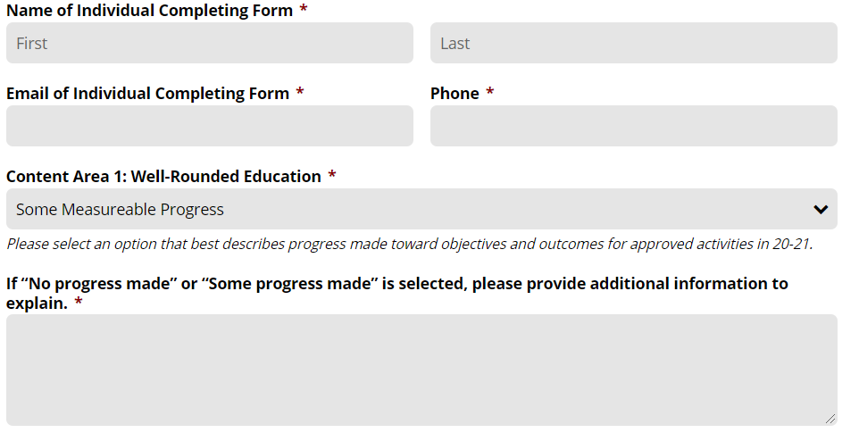
Evaluating Title IV Investments

Slide 25
Covid
We’re always happy to help, but…
Except for Equitable Services under ESSER I (Jesse), members of the CFP team are not primary contacts for CARES Act or ARPA funds (which include the ESSERs), nor for Covid Response Plans.
https://education.vermont.gov/news/covid-19-guidance-vermont-schools/covid-19-federal-emergency-funds

Slide 26
Questions?

