Slide 1
Equitable Services to Independent Schools
June 15, 2020

Slide 2
Topics
Equitable Services Basics
Consultation
Title IA
Title IIA and IVA
Title IIIA
Role of the Ombudsman

Slide 3
Equitable Services Basics

Slide 4
Equitable Services
Federal law allows federal education aid to be provided to children in need, regardless of whether they attend a public or eligible independent school.
Non-profit, approved or recognized elementary and secondary schools only—can be religious

Slide 5
LEA Control of Funds
The LEA controls all funds, title to materials, equipment, and property purchased. Independent schools receive services, not funds, and have no authority to spend.
The LEA plans, designs, and implements program (including procurement)—this can not be delegated to the independent school.
Services must be provided by an employee of the district or a 3rd party contractor.

Slide 6
Services
The LEA may place equipment and supplies in a private school for the period of time needed for the program, and only for the program.
Must be neutral, secular, and non-ideological
Services should be equitable (not necessarily identical) to the public school and designed to meet the needs of the independent school students and teachers.

Slide 7
Services
Services for independent school children should begin at the same time as services for public school children.
Consultation must occur before initial applications are drafted.

Slide 8
Obligation of Funds
Funds allocated to an LEA for educational services and other benefits to eligible independent schools must be obligated in the fiscal year for which the funds are received by the LEA.
There may be extenuating circumstances, however, in which an LEA is unable to obligate all funds within this timeframe.
  Under these circumstances, the funds may remain available for the provision of equitable services during the subsequent school year.

Slide 9
Consultation

Slide 10
Consultation
The process of outreach to and collaboration with eligible independent schools to design and develop the equitable services program
Non-profit, approved or recognized schools…
Within the LEA’s boundaries: Title IA, Title IIA, Title IIIA, Title IVA
Beyond the LEA’s boundaries: Title IA
  Title IA “follows” students who drive funds

Slide 11
Consultation
Initiating consultation is the responsibility of the LEA
If independent schools have not heard from the LEA, the independent school should reach out to start the process
The goal of all parties should be to reach an agreement on how to provide equitable and effective programs for eligible independent school children.
LEA must provide “timely and meaningful” consultation with appropriate independent school officials.

Slide 12
What is Timely?
  Before the LEA makes any decisions about reserving, transferring or consolidating funds.
  Before the LEA makes any decisions about opportunities for independent school participation.
  Meetings should continue throughout implementation and assessment of services.

Slide 13
What is Meaningful?
  Genuine opportunity for all parties to express their views, and all views seriously considered.
  The LEA may initiate consultation with a proposal for services.
  Final decisions made by the LEA after consultation.

Slide 14
Consultation Topics
  How the needs of eligible independent school students and staff have been identified
  What services the LEA will offer to eligible students and staff
  How, where, when and by whom the services will be provided
  How the efficacy of services will be assessed and how the results will be used to improve services

Slide 15
Consultation Topics
  Title IA: Which independent school students reside in an LEA attendance area that is served by Title I? Names and addresses.
  Title IA: Of these students, which are from low-income families?
    Use the same low-income poverty measure the LEA uses
    Use agreed-upon, comparable poverty data from a different source, such as a scholarship application
    Proportionality – apply the Title I school’s poverty percentage to the private school students residing in the attendance zone of Title I schools

Slide 16
Consultation and Documentation
LEAs and independent school officials must have the goal of reaching agreement on how to provide equitable services.
Written, signed affirmation of consultation with each eligible independent school within and beyond the boundaries of the LEA
  OR documentation of attempts to contact/consult
  OR written, signed affirmation of an Independent School choosing not to participate

Slide 17
Documentation
The affirmation must provide the option for independent school officials to indicate their belief that timely and meaningful consultation has not occurred or that the program design is not equitable/acceptable.

Slide 18
Documentation
Documentation of consultation must be collected by the SEA—be prepared to provide/upload this
Resources:
  Vermont Equitable Services Consultation Form
  Vermont Equitable Services Consultation Timeline

Slide 19
Title I Part A

Slide 20
Determining the Title IA Amount
The LEA determines its public school attendance areas (schools) participating in Title IA.
The LEA determines the number of children from low-income families residing in participating public school attendance area who attend public schools, and the number who attend independent schools.
The LEA applies these proportions to the total IA allocation to determine the IA Equitable Services set-aside amount

Slide 21
Example Title I Part A
Public Title I Attendance Area | Number of Low-Income attending public school | Number of Low-Income attending I.S. | Total Number of Low-Income Students
A-Apple School | 500 | 120 | 620
B-Banana School | 300 | 9 | 309
C-Cherry School | 200 | 6 | 206
D-Date School | 350 | 15 | 365
Total (Step 1) | 1,350 | 150 | 1,500
Proportionate Share (Step 2) | 90% | 10%
 | $900,000 | $100,000

Slide 22


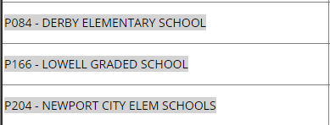
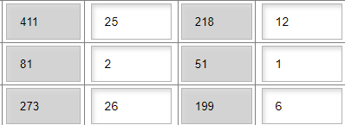
Title I Part A in GMS
Targeting and Ranking, Step 1A:

Slide 23
Does she drive Title IA funds?
A fourth grader who lives in the Essex-Westford SD attends Mater Christi, an eligible independent school in Burlington.
  The student’s family is not low-income, but she resides in the attendance area of a Title I elementary school.
  The student’s family is low-income, but she resides in the attendance are of a non-Title I elementary school.
  The student’s family is low-income, and she resides in the attendance area of a Title I elementary school.

Slide 24
Title I Part A & Independent School Services
Resident LEA is responsible for providing services for its eligible students, even if the students attend an independent school in another LEA.
Resident district may contract with another district to provide services.
Services must be Targeted Assistance

Slide 25
Allowable Uses of Title IA
Academic interventions
Extended learning time and tutoring
Supplemental professional learning for teachers in support of eligible students
Supplies/materials to implement initiatives
Parent and Family Engagement activities (families of eligible students)
Other
Simply providing a school with instructional materials is not allowable- supplies alone would not be a viable program

Slide 26
Student Eligibility to Participate in Service
1. Resides in participating public school attendance area (i.e., the area of a Title I Part A School); and
2. Identified as eligible for services through multiple, educationally-related criteria.
Poverty is what drives funds to the independent school—it is not the criteria for determining which students to serve

Slide 27
Title II Part A and Title IV Part A

Slide 28
Determining the Title II or Title IV Amount
The LEA determines the total enrollment of public schools & total enrollment of participating independent schools within the physical boundaries of the LEA
The LEA applies these proportions to the total IIA or IVA allocation (minus reasonable administration costs) to determine the equitable services set-aside amount
LEAs and independent schools should work together to determine acceptable, accurate enrollment numbers.

Slide 29
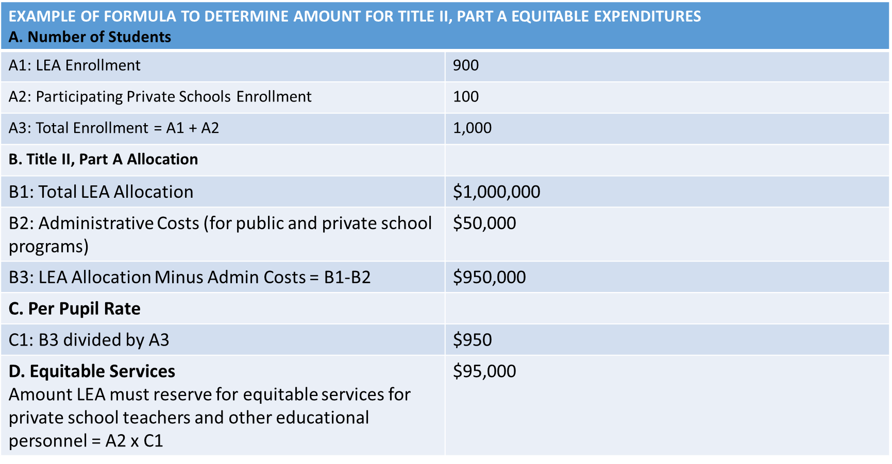
Example of Title II/Title IV Calculation

Slide 30
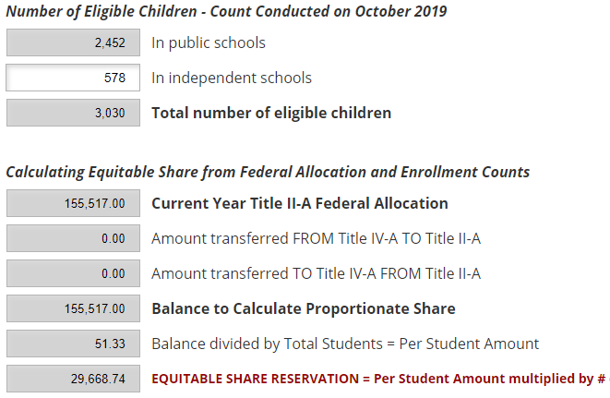
Title II/Title IV Calculation in GMS

Slide 31
Professional Development
LEAs are not allowed to reimburse independent schools directly for professional learning costs. However, an LEA may reimburse individual independent school teachers, principals or other school leaders for approved professional development or travel costs.
LEA may pay stipends directly to independent school teachers.
LEA may not pay for independent school substitute teachers.

Slide 32
Title III Part A

Slide 33
Determining the Title III Part A Amount
The LEA determines the number of ELs in public schools & number of ELs in participating independent schools within the physical boundaries of the LEA
The LEA applies these proportions to the total IIIA allocation (minus reasonable administration costs) to determine the equitable services set-aside amount
Only in LEAs with a Title III allocation, and only to independent schools that determined EL eligibility of students in the past year

Slide 34
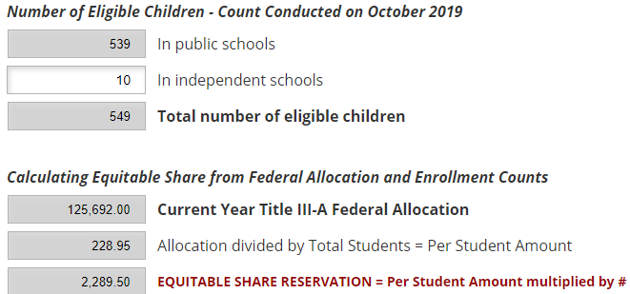
Title III Part A Amount in GMS

Slide 35
Ombudsman
Serve as the primary point of contact for addressing questions and concerns from independent school officials and LEAs regarding the provision of equitable services
Monitor and enforce the equitable services requirements
Jesse Roy | jesse.roy@vermont.gov | (802) 828-1390

Slide 36
Statutes
ESSA Section 1117: Title I, Part A
ESSA Section 8501: Titles II, III and IV
EDGAR: Sections 76.650-76.677
Non-Regulatory Guidance:
  Title IA
  Title III (2015)
  Title IIA, III and IVA (2009)

