Slide 1
Title IV, Part A Overview
CFP 101
October 21, 2021

Slide 2
Today’s topics
Title IV Overview
Allowable Uses
Budgeting Requirements
Writing Title IV Investments
Reporting Requirements

Slide 3
Title IV, Part A:
Student Support and Academic Enrichment Program
Purpose: To improve student academic achievement by increasing the capacity of States, local educational agencies, schools, and local communities to:
  Provide all students with a well-rounded education
  Improve school conditions for student learning (safe and healthy students)
  Promote the effective use of technology (EUT) in supporting academic achievement and digital literacy
Notes:
Within each of the three content areas (well-rounded education, safe/healthy schools, and effective use of technology), LEAs have broad flexibility to use funds for a variety of activities to improve student outcomes and address opportunity gaps that may be identified through the CNA, prioritization of schools and stakeholder engagement
Those three elements of the application are what provide the flexibility within the Title IV program to tailor investments based on the needs of their unique student populations within individual schools or within the LEA as a whole

Slide 4
Title IV Requirements
Comprehensive Needs Assessment
Prioritization of schools
Stakeholder engagement
Supplement not Supplant

Slide 5
Comprehensive Needs Assessment
An LEA that receives at least $30,000 in Title IV funds must conduct a comprehensive needs assessment
  Must focus on the 3 content areas
  Must include timely and meaningful consultation with stakeholders
  Must examine relevant data to understand students’ and schools’ needs
Notes:
Must examine areas for improvement related to the three content areas: students’ access to well-rounded educational opportunities, learning conditions that ensure safe and healthy environments for students, and effective use of technology
Data inventory
Required to complete the Title IV section for all LEAs receiving Title IV funds
Captures relevant data to support investments
Data represented in the CNA/Data Inventory, along with stakeholder engagement and prioritization of schools, is what drives the flexibility afforded in Title IV to tailor investments to your LEA/school/student population

Slide 6
Prioritizing Distribution of Funds
LEAs, or a consortium of LEAs, must prioritize the distribution of funds to schools served by the LEA
Factors must include:
  Schools with the greatest need
  Schools with the highest numbers of students from low-income families
  Schools identified for comprehensive support and improvement under Title I
  Schools implementing targeted (equity) support and improvement plans under Title I
  Schools identified as persistently dangerous
Notes:
LEAs must prioritize distribution of funds to schools based on one or more of these factors
“schools with the greatest needs” is as determined by the LEA – this will likely be driven by the comprehensive needs assessment and a common place to identify this is in the data inventory

Slide 7
Stakeholder Engagement
During the design and development of applications, an LEA or a consortium of LEAs must engage in consultation with stakeholders in the area served by the LEA
Stakeholder engagement must be on-going and continuous: LEAs must continue to consult with the identified stakeholders to improve the activities it conducts and coordinate implementation with other related activities conducted in the community

Slide 8
Required Stakeholders
Stakeholders to be consulted must include, but are not limited to:
  Parents
  Teachers
  Students
  Principals
  School leaders
  Specialized instructional support personnel
  Indian tribes or tribal organizations, when applicable
  Local government representatives
  Community-based organizations
  Others with relevant and demonstrated expertise
Notes:
Not an exhaustive list—other stakeholders that could be involved might include: members from the business community, health providers, social workers, police, librarians, technology experts, etc.

Slide 9

Stakeholder Groups
School staff organizations
  Teachers’ unions
  Professional associations
Parent and Family Organizations
  Parent-teacher organizations or associations
  Parent advocacy groups
District and School Leaders
  School boards
  School administration
  District administration
Student and Youth Organizations
  Student clubs, activities, and government
  Youth-serving community-based organizations
Government and Community Groups
  Local government officials
  Local child welfare, juvenile court or law enforcement agencies
  Faith-based organizations
Nonprofit organizations providing support and education services
  After-school services
  Community health services
  Mental health services
  Job and career training
  STEM education
  Drug and violence prevention
Nonprofit organizations serving vulnerable populations
  Court-appointed special advocates
  Homeless shelters
  Food pantries/banks
  Juvenile defenders
  LGBTQ youth-serving organizations
  Children in the welfare system
Notes:
Consider how the school or LEA can coordinate and collaborate to increase and improve activities and services within the three content areas.

Slide 10
Supplement Not Supplant
An LEA may not use these funds for the cost of activities if the cost of those activities would have otherwise been paid with State or local funds in the absence of Title IV funds
Two presumptions of supplanting:
  An activity required by Federal, State, or local law
  An activity paid for with State or local funds in the prior year
Notes:
The proposed use of funds for the activity must supplement, and not supplant, other State or local funds that would otherwise be used to pay for the allowable activity
LEAs may not provide required core academics or classes with Title IV; activities need to be above and beyond the what is required, and need to enrich the content or curriculum

Slide 11
Supplement Not Supplant
Ask the following questions:
  Is the program required by federal, State, or local law?
  Were local funds used to pay for the program in prior years?
  If the LEA did not have federal funds available to conduct this activity, would the LEA still conduct it with State or local funds anyway?

Slide 12
Title IV Allowable Uses

Slide 13
In general…
Allowable uses under each of the three content areas in Title IV may include:
  Direct services for students
  Professional development for teachers and administrators
  Salaries of personnel to carry out identified programs and services
  Supplemental educational resources and equipment

Slide 14
Well-Rounded Educational Opportunities
Purpose: To provide an enriched curriculum and education experiences to all students
Diverse learning experiences that engage students across a variety of courses, activities, and programs
Allows students to make connections between subjects
Provides all students access to a holistic education

Slide 15
Well-Rounded: Allowable Uses
Programs and activities to improve instruction and student engagement in STEM subjects
Accelerated learning programs
College and Career counseling
Social-Emotional Learning
Programs and activities that support:
  Music & art
  History, civics, government, economics, geography
  Foreign languages
  Environmental education
Notes:
A well-rounded education should engage students across a variety of subjects, that may include literacy, math, science, technology, engineering, foreign languages, history, art, geography, music, health, etc.
How is the activity enriching the curriculum or adding additional supports to ensure success for all students? How is it above and beyond what is required for the basic education program? Is it supporting cross-disciplinary approaches? Etc.
How is it supported by your data?
There can be significant overlap between the Title IV content areas – investments that could fall under either well-rounded and safe/healthy, or well-rounded and effective use of technology
Example: Investment for a software platform that supports equitable access to post-secondary opportunities and helps students align college and career interests and goals – this could fall under EUT (tools for planning for future education) OR well-rounded (college and career readiness). The content area will depend on your data, results of stakeholder engagement, and the wording of the investment (i.e., what is the purpose or intent of the activity?)
As always, the flexibility here will depend on the wording of the investment (both the purpose and activity), data to support that need, and input from stakeholders

Slide 16
Safe & Healthy Students: Allowable Uses
Purpose: To improve school conditions for student learning
Safe & Supportive Schools
Bullying and harassment prevention
School dropout prevention
Reducing use of exclusionary discipline practices
Building school and community relationships
Culturally Responsive Teaching
Student Physical & Mental Health
Healthy, active lifestyles
Nutritional education
Trauma-informed classroom
Drug and violence prevention
School-based health and mental health services
Preventing use of alcohol, tobacco, and other drugs
Notes:
Schools that identify and include specific mental health services for students increase the likelihood of students’ academic success
Section 4108 (safe and healthy students) funds can be used for a wide array of programs and activities that directly support student health and wellness, as well as professional development and training for school personnel
Allowable uses under safe and healthy students content area fall into two broad categories: learning environment and the physical and mental health of students

Slide 17
Safe and Healthy Students: Parent Permission
An LEA must obtain prior written, informed consent from the parent of each child who is under the age of 18 to participate in any mental health assessment or service that is funded with Title IV, Part A
Prior written, informed consent means active consent; silent (passive) consent does not constitute prior written, informed consent and is therefore not sufficient.
Section 4001 of the ESEA describes in detail the contents of such consent, as well as limitations and exceptions to when prior, written informed consent is required.

Slide 18
Effective Use of Technology
Purpose: To increase the effective use of technology to improve the academic achievement, academic growth, and digital literacy of all students
Expanding growth and learning opportunities
Building capacity for blended learning opportunities
Notes:
Purpose: Improving how technology is used in the classroom to increase student academic achievement – the focus is on improving the practice; there is some allowability for supplies, but the intent is to build capacity and success through training and PD

Slide 19
Effective Use of Technology
Program funds may be used to provide educators, school leaders, and administrators with the professional learning tools, devices, content and resources to do the following activities:
Provide personalized learning
Discover, adapt, and share high-quality resources
Implement blended learning strategies
Implement school- and district-wide approaches to inform instruction, support teacher collaboration, and support personalized learning
Develop or implement specialized or rigorous academic courses using technology; and
Support professional learning for STEM, including computer science

Slide 20
Effective Use of Technology: Special Rule
The majority of spending under EUT must be used to support:
  Professional development activities
  Other activities directly related to improving how educational technology is used
No more than 15% of spending under EUT may be used to purchase technology infrastructure
  Infrastructure: devices, equipment, software applications, platforms, digital instructional resources, other one-time IT purchases
Notes:
In order for technology to be most effective, educators must have the knowledge and skills to take full advantage of technology-rich learning environments

Slide 21
Effective Use of Technology: Allowable Uses
Non-infrastructure
  Professional development
    Using technology effectively in the classroom
    Using technology to inform instruction
  Programs and activities that support:
    Digital literacy and citizenship
    Personalized learning
    Blended learning
Infrastructure
  Devices, equipment, software applications, platforms, digital instructional resources, other one-time IT purchases

Slide 22
General Title IVA Allowability Advice
Is the proposed activity informed by the results of a needs assessment, stakeholder engagement, and prioritization of schools?
Is the proposed activity consistent with one of the three content areas of Title IV?
  Well-rounded education, safe and healthy students, effective use of technology
Is the cost of the activity allowable in accordance with the cost principles in the Uniform Grant Guidance of 2 CFR Part 200, Subpart E?
  Is it reasonable, necessary, and allocable?
Does the proposed use of funds supplement, and not supplant, other State or local funds that would otherwise be used to pay for the allowable activity?
Is the activity one of the prohibited activities in section 4001(b) or 8526 of the ESEA?
Notes:
Necessary
Is the proposed activity supported by data representing a clear need? – Support the need for the activity in the Data Inventory
Reasonable
Would a prudent person pay this amount for this item? - Provide details, as appropriate
Example: Are you budgeting $10,000 for 50 devices or 1?
Example: If budgeting $50,000 for PD activity, how many people are participating, for how many days, with how many consultants, etc.?
Allocable
Is it chargeable to the grant award in proportion to the benefits received by the grant award as a result of the cost?

Slide 23
Prohibited Activities: ESEA §4001
ESEA §4001(b) Prohibited Use of Funds
No funds under this title may be used for medical services or drug treatment or rehabilitation, except for integrated student supports, specialized instructional support services, or referral to treatment for impacted students, which may include students who are victims of, or witnesses to, crime or who illegally use drugs.

Slide 24
Prohibited Activities: ESEA §8526
ESEA §8526 Prohibited Uses of Funds
No funds under this Act may be used—
For construction, renovations, or repair of any school facility, except as authorized under this Act
For transportation, unless otherwise authorized under this Act
To develop or distribute materials, or operate programs or courses of instruction directed at youth, that are designed to promote or encourage sexual activity
To distribute or aid in the distribution of any organization of legally obscene materials to minors on school grounds
To provide sex education of HIV-prevention education in schools unless that instruction is age-appropriate and includes the health benefits of abstinence
To operate a program of contraceptive distribution in schools

Slide 25
Title IV Budgeting Requirements

Slide 26
Budgeting Requirements: Over $30,000
If an LEA receives more than $30,000 in Title IV funds, the LEA must meet all three budgeting requirements:
  Minimum 20% in well-rounded,
  Minimum 20% in safe and healthy, AND
  A portion of the allocation (up to 60%) in effective use of technology
Notes:
Once minimum budgeting requirements have been met, LEAs can budget the remainder of the funds in any of the three content areas

Slide 27
Budgeting Requirements: Under $30,000
If an LEA receives less than $30,000 in Title IV funds, the LEA must meet at least one of the budgeting requirements:
  Minimum 20% in well-rounded,
  Minimum 20% in safe and healthy, OR
  A portion of the allocation (up to 60%) in effective use of technology

Slide 28
Title IV, Part A Special Rule: EUT
At least 85% of the effective use of technology funds must be used to support professional learning to enable the effective use of educational technology, which may include collaborative efforts to develop and disseminate best practices and resources
LEAs or consortiums of LEAs may not spend more than 15% of the funds available in this section on infrastructure (devices, equipment, software applications, platforms, digital instructional resources and other one-time IT purchases)
Notes:
Focus of this content area is on the improving the practice of using technology in the classroom – there are some funds for supplies/infrastructure to ensure readiness, but they are limited…don’t think of the effective use of technology content area as funds for tech supplies!
Consider equitable services here as well: the budgeting requirements apply to the LEA’s total Title IV allocation – investments written for participating independent schools count toward the budgeting requirements. That also means that if an independent school requests to put their entire portion of Title IV dollars toward tech infrastructure, it may exceed the 15% cap and/or there won’t be any remaining tech infrastructure funds for the LEA’s public schools.

Slide 29
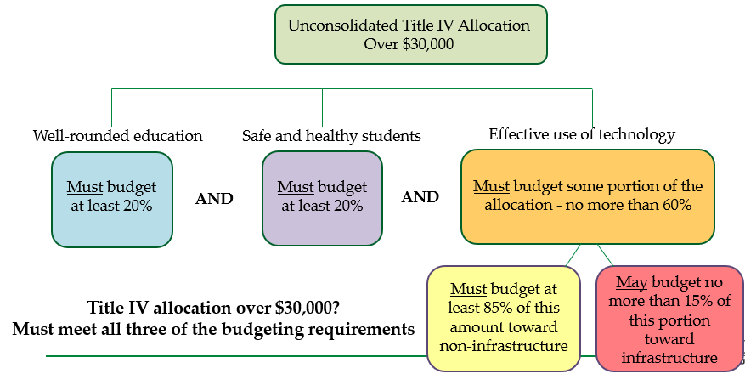
Distribution Requirements: More than $30,000

Slide 30
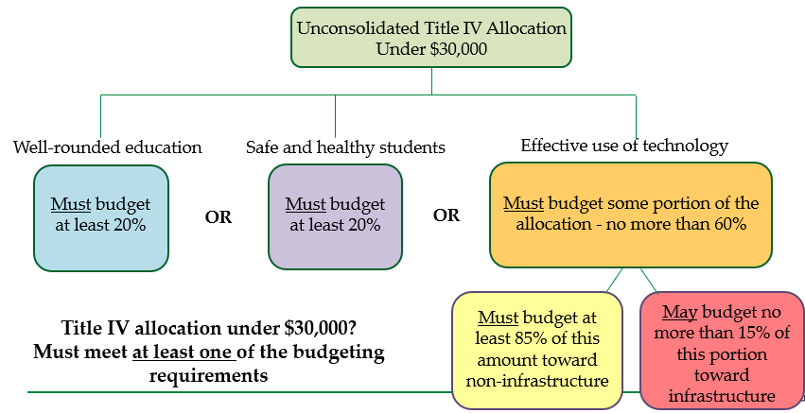
Distribution Requirements: Under $30,000

Slide 31
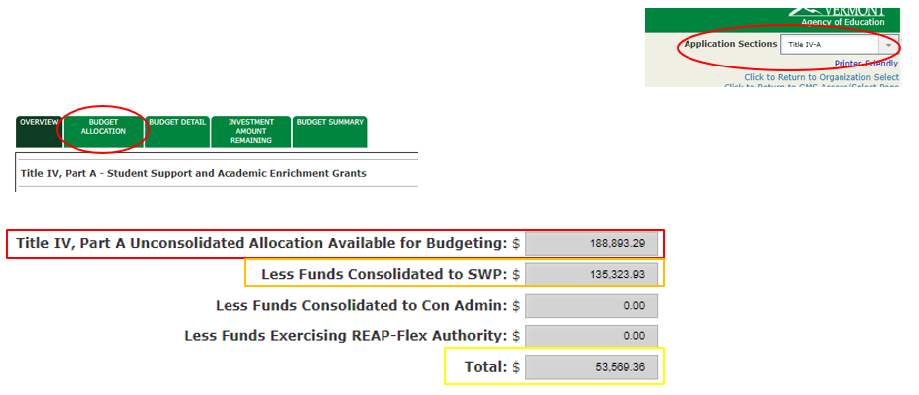
Calculating Budgeting Requirements in GMS

Slide 32
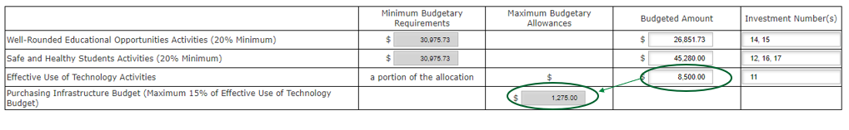
Calculating Budgeting Requirements in GMS
Notes:
Table in GMS calculates the minimum/maximum budgeting requirements based on the LEA’s allocation

Slide 33
Consolidating Title IV into SWP
Title IV funds may be consolidated in a schoolwide program and do not have to be tracked for specific compliance with the requirements of Title IV (e.g., budgeting requirements)
Any school where Title IV funds have been consolidated in the SWP must have at least one investment that meets the intent and purpose of Title IV (the original funding source)

Slide 34
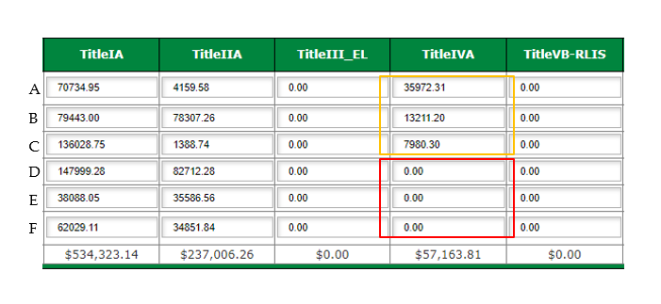
Schoolwide Programs
Notes:
Must be at least one investment that meets the intent of Title IV at schools A, B, and C because Title IV funds are pooled there.
The Title IV reviewer will not review investments at schools D, E, or F because no Title IV funds are pooled there. If investments are written at schools D, E, or F that only meet the intent of IV and do not meet the intent of any of the other pooled funding sources (in this case, Title I and Title II), the LEA may receive feedback around allowability of these investments.

Slide 35
Writing a Title IV Investment

Slide 36
Purpose Statement
Provide a purpose: briefly describe the program objectives
  What is the identified need that you are trying to meet?
  What are the goals or objectives for this activity?
  How do the objectives align with the intent of Title IV?
  The purpose must be more specific than stating one of the three content areas of the program
Notes:
Keep the purpose or objective specific and focused on the data – should be clear from the purpose what need you are trying to meet

Slide 37
Activity
Provide a description of the activity/strategy and the intended outcomes
  What activity will you implement to meet the identified need?
Notes:
Provide necessary details
“In order to increase student success in STEM, contract with consultant” is not sufficient detail – unable to determine what the activity is…PD? Direct service to students?

Slide 38
Evaluating Effectiveness
Provide a description of how the LEA will periodically evaluate the effectiveness of the activity
  What specific evaluation methods will be used to measure the success of this activity?

Slide 39
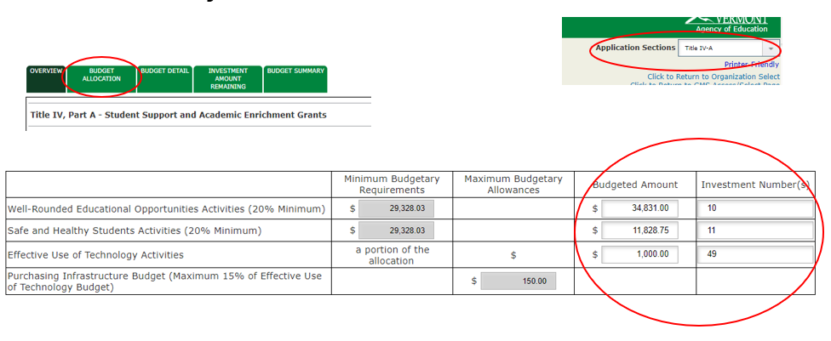
Identify the Content Area for Investments
Notes:
In GMS, grayed out boxes are automatically populated, white boxes are for the LEA to complete—indicate in the Budgeted Amount column the total amount you have written investments for in each content area and the corresponding investment number in the Investment Number column.

Slide 40


Approvable Title IV Investments
“In order to provide safe and healthy schools to increase academic achievement, consultant to provide PD.”
“In order to continue building capacity of staff to support student social-emotional learning that will decrease classroom disruptions and increase time for instruction, one consultant to provide 10 hours PD in trauma-informed practices for up to 25 staff. Success to be monitored and measured by SWIS data and decrease in behavior referrals”
Notes:
First example: non-specific, likely challenging to tie this to a data-supported need, not clear what activity is being funded…
Second example: Clear objective, provided details around the PD to be provided, provided the measure for how this will be evaluated.

Slide 41
Writing Approvable Title IV Investments
Provide a clear objective, description of the activity, and an evaluation method
Ensure that the investment is allowable, necessary, and reasonable
  Allowable Uses document
  Data Inventory
  Provide appropriate details
Identify the intended content area (Budget Allocation tab)
Refer to the Writing an Approvable Investment document and reach out with questions

Slide 42
Data Reporting

Slide 43
Consolidated State Performance Reporting (CSPR)
Title IVA Indicators
Indicator 2.6.1: Funds spent under Title IVA
  The amount of funds spent by LEAs on the three content areas under Title IV
Indicator 2.6.2: LEAs who spent funds under Title IVA
  The number of LEAs who spent funds by the content areas under Title IV
Additional Indicator
Indicator 2.7.3: LEA funds transfer
  Funds transferred into or out of Title programs
Notes:
Two data indicators that are Title IV-specific in the CSPR; one indicator that applies to Title programs when funds have been transferred – will need to be reported if the LEA transfers funds into or out of Title IV

Slide 44
Title IVA Data Reporting
Each State that receives an allotment under Title IV Part A for a fiscal year must publicly report on how funds are being spent by LEAs, including the degree to which LEAs have made progress towards meeting the objectives and outcomes described in the Title IVA grant applications (ESEA §4104(a)(2))
Use of Funds: How LEAs are spending funds to meet the percentage distribution requirements across the content areas
Performance Reporting: Degree to which LEAs have made progress toward meeting their described objectives and outcomes

Slide 45
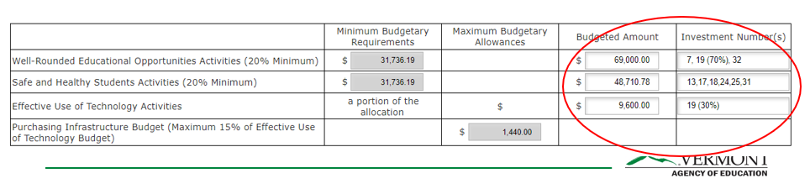
Identifying Content Areas within the Application
LEAs should refer to their approved application to inform how funds will be counted for purposes of data reporting
If an LEA has an activity that could fit into more than one of the Title IV content areas, the LEA must explain in the application how the activity fits in more than one content area and include the amount of funds allocated by content area to the activity
  Purpose statement/data inventory
  Investment number column
Notes:
If an LEA has an activity that could fit into more than one of the Title IV content areas, the LEA must explain in the application how the activity fits in more than one content area (purpose statement/data inventory) and include the amount of funds allocated by content area to the activity (investment number column, within the investment description, or upload additional documentation)

Slide 46

Questions?

Slide 47
Guiding Resources
Title IV Allowable Uses
Writing an Approvable Investment
Title IV Non-Regulatory Guidance

Slide 48
Contact Information
Katy Preston
Title IV Director
Katy.preston@vermont.gov

