Slide 1
Title IIA Overview
&
Writing Approvable CFP Investments
October 21, 2021

Slide 2

Technology Stuff
Please mute your microphone
Please turn off your web cam
Ask questions in the chat function

Slide 3
Title IIA Overview
Preparing, Training, and Recruiting High-Quality Teachers, Principals, or Other School Leaders
Part A: Supporting Effective Instruction
ESEA §2103(b)

Slide 4
What are the intents of Title IIA?
The purpose of Title II Part A is to:
Increase student achievement consistent with state standards;
Improve the quality and effectiveness of teachers, principals, and other school leaders;
Increase the number of teachers, principals, and other school leaders who are effective in improving student academic achievement in schools; and
Provide low-income and minority students greater access to effective teachers, principals, and other school leaders

Slide 5
What can it be used for?
Needs- and Evidence-Based Professional Development
  Must be supported by Data Inventory
Development and Implementation of Teacher Evaluation and Support Systems
Induction & Mentoring
  Must be in excess of what is required by EQS to avoid supplanting
Academic Coaching for Teachers
Recruiting and Retaining Effective Educators
Supporting Early Learning Educators
Must supplement, not supplant
For more information, check out the Title IIA Allowable Uses document available on the CFP website and the Title IIA Non-Regulatory Guidance published by the USDOE.

Slide 6
What staff can use these funds for PD?
Teachers
Principals
Instructional Paraprofessionals
Academic Coaches*
  If salaried employees paid by Title IIA
Other School Leaders*

Slide 7
Who is considered an “Other School Leader”?
According to ESEA §8101(A)(44):
“The term ‘school leader’ means a principal, assistant principal, or other individual who is—
(A) an employee or officer of an elementary school or secondary school, local education agency, or other entity operating an elementary school or secondary school; and
(B) responsible for the daily instructional leadership and managerial operations in the elementary school or secondary school building.”

Slide 8
Purchasing Equipment, Supplies & Materials under IIA
The only time equipment, supplies & materials may be purchased with IIA funds is if they are necessary to complete a Title IIA-funded PD activity.
Some examples of allowable* purchases:
Books for a IIA-funded teacher book club
Flip charts, markers and folders for a IIA-funded PD activity
Required texts for a IIA-funded course
*Allowability is always dependent on a number of factors; an investment is not automatically allowable simply because it was allowed in the past.

Slide 9
Purchasing Equipment, Supplies & Materials under IIA (cont. 1)
As IIA-funded equipment, supplies & materials must be tied to a IIA-funded PD activity, they must be included within the investment for the PD activity itself.
Stand-alone IIA investments for equipment, supplies & materials cannot be accepted.

Slide 10
Purchasing Equipment, Supplies & Materials under IIA (cont. 2)
The following examples are not allowable purchases under IIA:
Teacher laptops with accompanying PD* on how to effectively use them in the classroom
Entire curriculum sets for teaching staff with accompanying PD* on implementation
Supplies for use in the classroom and/or by students
*In these cases, the PD itself including BCO time, facility fees, consultants, etc. could likely be funded under IIA, just not the listed equipment/materials.

Slide 11
Title IIA Do’s
DO:
Plan ahead!
Support all investments with data
Provide evidence-based PD activities
Look at specific PD needs within teaching staff
Submit job descriptions for FTEs funded by IIA

Slide 12
Title IIA Do’s (cont. 1)
DO:
Make sure that FTEs match the time spent specifically performing duties directly related to the intents of Title IIA
  If a FT staff member is only providing coaching for 20% of their time (8 hours a week), only .2FTE of their salary may be paid for with IIA
  Be prepared to provide time and effort logs if requested

Slide 13
Title IIA Do’s (cont. 2)
DO:
Double check that you have all necessary information in your investment description or as an upload
For PD Investments:
- How many participants/who?
- Duration of PD?
- # of Consultants?
- Any Beyond Contract Obligation (BCO) time?
If uploading documentation, please add “supporting documentation attached” to your Investment Description or it may get missed during review.

Slide 14
Title IIA Don’ts
DON’T:
Submit “placeholders” for unplanned PD
PD Investment Descriptions must include:
Number of and type of staff (can be written as “up to _____”)
  To determine reasonableness and allowability
Duration of PD (can be written as “up to _____”)
  To determine reasonableness and allowability
  Must be meet ESEA definition of “professional development” as “sustained (not stand-alone, 1-day, or short-term workshops), intensive, collaborative, job-embedded, data-driven, and classroom-focused” ESEA §8101(A)(42)

Slide 15
Title IIA Don’ts (cont. 1)
DON’T:
Submit “placeholders” for unplanned PD
PD Investment Descriptions must include (if applicable):
  BCO time
  Materials
  Any other fees covered such as:
    Consultant fees
    Registration fees

Slide 16
Title IIA Don’ts (cont. 2)
DON’T:
Be afraid to ask questions ☺
Contact:
  Megan Kinlock
  Director of Title IIA & Migrant Education
  megan.kinlock@vermont.gov
  * (802) 828-1472

Slide 17
Writing Approvable CFP Investments

Slide 18
What is a CFP Investment?
CFP Investments are statements made by the LEA that describe, in detail, their intended strategies for utilizing CFP funds for addressing needs and problems.

Slide 19
What Purpose Does a CFP Investment Serve?
CFP Investments…
Identify a data-supported need
Identify strategies and/or activities to address the need
Help the CFP Team determine approvability of the Investment

Slide 20
Approvability

Slide 21
What Determines Approvability?
When the CFP Team examines an investment, they ask:
Is this investment reasonable?
Is this investment necessary?
Is this investment allowable?
Is this investment allocable?
Another important consideration…
Supplement not supplant

Slide 22
Reasonable
What is reasonable is defined by the Code of Federal Regulations (CFR) in 2 CFR §200.404*:
“A cost is reasonable if, in its nature and amount, it does not exceed that which would be incurred by a prudent person under the circumstances prevailing at the time the decision was made to incur the cost.”
*The definition of “reasonable” can also be found in OMB Circular A-21

Slide 23
Reasonable: 2 CFR 200.404 Continued…
In determining reasonableness of a given cost, consideration must be given to:
(a) Whether the cost is of a type generally recognized as ordinary and necessary for the operation of the non-Federal entity or the proper and efficient performance of the Federal award.
(b) The restraints or requirements imposed by such factors as: sound business practices; arm's-length bargaining; Federal, state, local, tribal, and other laws and regulations; and terms and conditions of the Federal award.
(c) Market prices for comparable goods or services for the geographic area.
(d) Whether the individuals concerned acted with prudence in the circumstances considering their responsibilities to the non-Federal entity, its employees, where applicable its students or membership, the public at large, and the Federal Government.
(e) Whether the non-Federal entity significantly deviates from its established practices and policies regarding the incurrence of costs, which may unjustifiably increase the Federal award's cost.

Slide 24
Details, Details, Details…
Details are very important in determining if an investment is reasonable.
If an investment is overly vague and lacks the details necessary to determine if it is reasonable, it will get returned and more information will be requested.
Keep in mind that the CFP Team only has the information you have provided in the Investment Description and attached documentation. Please do NOT assume we know anything about your Investment strategies or activities.
Plan ahead to the extent that it is feasible as placeholders are NOT allowable anywhere on your CFP Application. Typically, “TBD” shouldn’t appear in your investments.

Slide 25
What Information Helps?
Context is very important in determining whether or not an Investment can be considered to be “reasonable.”
How many individuals will participate in a PD activity?
  2 people vs. 25 people
What supplies are being purchased?
  25 copies of Jim Knight’s Impact Cycle to accompany coaching PD vs. Flip charts
Where is a conference being held, if asking for travel costs?
  Travel to and from Albuquerque, NM vs. Travel to and from Stowe, VT

Slide 26
Example: Overly Vague
“To provide high quality academic instruction, TBD provide training for supporting students who are struggling.”
What is missing to determine if this is reasonable?
Training is defined as “TBD”
  While procurement guidelines must be followed, you should have a rough idea of the PD you are asking for funding for. Otherwise, this is a placeholder.
“To provide high quality academic instruction” does not necessarily define a need. All schools should be trying to provide high quality instruction.
  Tie this to your data. Is there a particular academic area that has data supporting a need for improvement in instruction? What is the end goal? i.e. “To improve instructional practices in order to increase proficiency levels on math assessments…”
How many teachers will participate in this training?
How long is the training? Will this be a one-day training, a series, job-embedded, etc.?

Slide 27
Let’s Fix It!
Example 1:
“To provide high quality academic instruction, TBD provide training for supporting students who are struggling.”
“To improve instructional practices in order to increase proficiency levels on math assessments, provide 4 half-day trainings during in-service days for up to 15 math teachers.”

Slide 28


Reasonableness Outside of CFP
Still frustrated by what is reasonable or not? That’s okay!
Suppose I asked you for $50 for ice cream…is that reasonable? That depends…
$50 for ice cream for one person
$50 for ice cream for 20 people
Details and context are important!

Slide 29
Necessary
What is necessary is based on the data you have.
If you think your LEA needs something, ask yourself:
How do you know you need it?
Data – Quantitative and Qualitative
  Assessments
  Behavior referrals
  Teacher evaluations
  Surveys
    Staff members
    Students
    Parents

Slide 30
Fear Not Your Data!
It can be difficult for even the most data-savvy person to organize many different types of data from many different sources and platforms into a usable format.
Data Inventory
Not intended to be a narrative or a “final product” but a tool
A “dumping ground” for all of your data to help you look at the big picture
Remember that the CFP Application takes a village!
Communicate with the folks who manage the data at your LEAs and let them help you.

Slide 31
Want vs. Need
Broken record:
Remember when you are planning your CFP Investments that their necessity must be backed up by data.
WANT
Wouldn’t it be nice to…
OR
We would like to…
We need to…
OR
We must…
NEED
VS
Investments NOT supported by data CANNOT be approved.

Slide 32
Allowable
The term “allowable” refers whether or not a particular strategy or activity is permissible based on statute; the statutes that determine allowability for Title programs can be found within the Elementary and Secondary Education Act of 1965, reauthorized as the Every Student Succeeds Act in December 2015.
In addition to statute, the Department of Education has created Non-Regulatory Guidance documents for each of the Titles.

Slide 33
Allowable Uses
While some Investments may meet the intents and allowability of more than one Title, each Title program (IA, IIA, IIIA & IVA) has its own intents and allowable uses.
Vermont’s “Allowable Use” documents are available on the CFP website for:
Title IA
Title IIA
Title IIIA
Title IVA
McKinney-Vento
Administration
Parent & Family Engagement
If you have a question about the allowability of an Investment, reach out the CFP Team ☺

Slide 34
Allocable
According to EDGAR/CFR, a cost is allocable to a federal award if the goods or services involved are chargeable or assignable to the federal award or cost objective in accordance with the relative benefit received.
An important aspect of allocability is that the particular investment is necessary to the overall operation of the non-federal entity (in this case, your LEA) and without these funds the services, activities, etc. would not occur.

Slide 35
Allocable (cont.)
Costs can, and should, be distributed in proportions if it benefits both the Federal award and other work of the non-federal entity
For example if you have an individual who is 1.0 FTE interventionist, who is paid .5 by a Federal award and .5 by local funds
This means that 50% of this individual’s time must be spent on activities related to the intents of the Title or funding source being charged
If you need to purchase this individual a computer, only 50% of the cost of the computer can be allocated to the Federal award
Say the same individual needed supplies/materials to do the interventions, allocable would be 50% paid by the Federal source of funds and 50% by local funds
Basically the grant can only pay for the portion that benefits the intentions of the funding source.

Slide 36
Scopes of Work

Slide 37
What IS a Scope of Work?
A Scope of Work, for the purposes of the CFP Application process, is a document that provides a detailed account of an Investment to assist with justifying its approvability.
According to the “Writing Approvable CFP Investments” document, it must contain the following information:
Why the activity is necessary
The timeline for the specific activities/deliverables
The costs associated with the project activities
Rationale for exceeding fair market price
The process by which the service outcomes will be measured, or more simply…how will you know that your intervention was successful?

Slide 38
When is a Scope of Work Needed?
For the CFP Application, you could be asked to produce a Scope of Work for any Investment in order to determine if it meets the 4 criteria of:
Reasonable
Necessary
Allowable
Allocable
However, a Scope of Work is mandatory for any Investment that exceeds “Fair Market Value” for the particular strategy or activity in the State of Vermont.

Slide 39
When is a Scope of Work Needed (cont.)
Most commonly, a Scope of Work will be required to justify consultant fees that exceed the Fair Market Value as defined in the CFP Document “Writing Approvable CFP Investments,” though it may be required for any other Investments who cost requires justification.
If you are attaching a Scope of Work or any other documentation to support an investment, you must include “Supporting documentation attached” within the Investment Description.

Slide 40
Fair Market Value
According to EDGAR, Fair Market Value is defined as “market prices for comparable goods or services in the geographic area.”
The market price for external consultants in Vermont shows a range of $350.00 to $2000.00 per day. Please note that the total for consultant fees must reflect all related expenses, including:
Materials
Travel
If you know that your consultant fees do NOT exceed the Fair Market Value, it is helpful for the CFP Team if your Investment Description contains “not to exceed $2,000/day” so it is clear that a Scope of Work is not necessary.

Slide 41
Scope of Work Template
We know that you are busy and wearing many hats, so we have developed an optional Scope of Work Template to make sure that we get all of the necessary information the first time.
Using this template in its entirety should minimize returned applications for missing/additional information. Providing only some of the information requested it likely to result in your application getting sent back to you.
Trust us, we do not like returning applications any more than you like getting them back…so let’s take a look at the Scope of Work Template.

Slide 42
How to Use the Scope of Work Template
The Scope of Work Template is intended to be completed electronically, saved and uploaded to your CFP Application.
Though it is available as a Microsoft Word Document, we recognize that many schools are Google schools, and it is easily utilized in Google Docs too. If you are uploading Google Docs files or linking to Google Docs within your Scope of Work, please note that we will be unable to open Google Docs per AOE policy.
When uploading any documentation to your CFP Application, please name uploaded files to clearly identify the investment they are supporting
(i.e. Investment 25 – Scope of Work.docx)
This will allow us to easily identify what Investment the documentation belongs to, and will speed up the application review process.

Slide 43
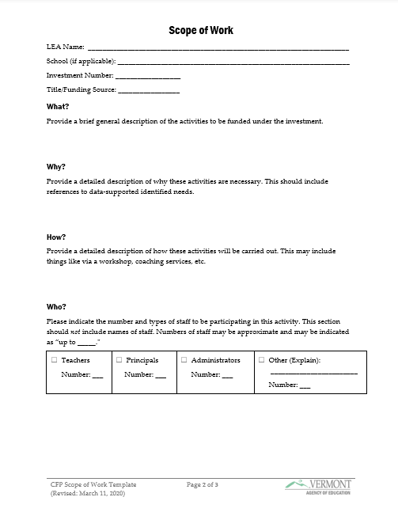
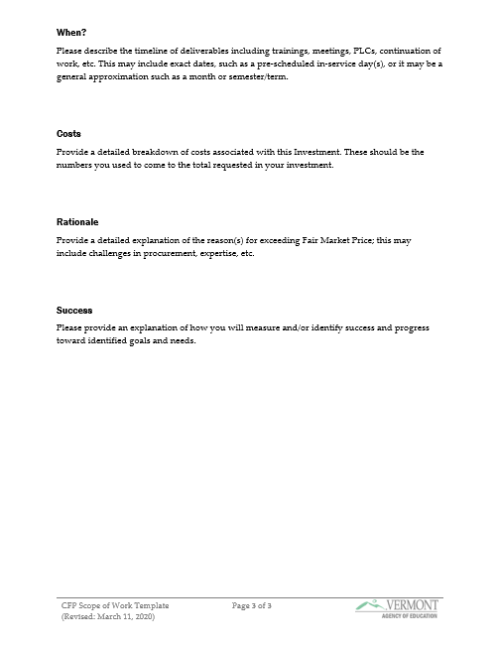
The Template
Please see the “Writing Approvable Investments” webinar and related materials on the CFP website at https://education.vermont.gov/student-support/federal-programs/consolidated-federal-programs for a more detailed and step-by-step guide to completing the Scope of Work Template.

Slide 44
But I Don’t Want to Complete MORE Paperwork!
While providing a Scope of Work is mandatory for investments that exceed Fair Market Value (or when requested by a CFP Team Member to determine approvability of an investment), the use of the Scope of Work Template is optional and intended as a tool to help you provide us the necessary information.
If you are providing another format of a Scope of Work, it must contain all of the same information requested on the Scope of Work Template and it must be all within one document.
Simply uploading a course/workshop description, printouts of information from websites, etc. or uploading multiple attachments will not be accepted.

Slide 45
Wrapping Up

Slide 46


Approvability At-a-Glance
Remember that in order to be approvable, the CFP Team must be able to determine that the investment is:
Reasonable
Necessary
Allowable
Allocable

Slide 47
Scopes of Work At-a-Glance
Scopes of Work are mandatory for any investment that exceeds Fair Market Value
  $2,000/day or $250/hour (pro-rated) for consultants
A Scope of Work may be requested by a CFP Team Member if additional information is needed about your investment for review even if it does not exceed Fair Market Value

Slide 48
Scopes of Work At-a-Glance (cont.)
You may use the provided Scope of Work Template or another document for your Scope of Work
  Must be uploaded to the CFP Application and given a file name that clearly indicates which investment it belongs to – i.e. “Investment 25 – Scope of Work.docx”
  If not using the Scope of Work Template, remember your submitted document must:
    Be a single document
    Contain all of the same information requested on the Template
  Be sure to include “Supporting Documentation attached” in your Investment Description so your Scope of Work does not get overlooked during review.

Slide 49

Remember…
The CFP Team is here to help you – don’t be afraid to ask questions!
That is what we are here for!
Help us help you.
We like pressing the “Approve” button!

Slide 50
Important Documents
Reference Documents
Writing Approvable CFP Investments
Webinar Recording: Writing Approvable Investments
Schoolwide Program Requirements
Allowable Use Documents
Title IA
Title IIA
Title IIIA
Title IVA
McKinney-Vento
Administration
Parent & Family Engagement
Templates
Scope of Work Template
Data Inventory
All CFP documents, including those listed here, can be found on our website:
https://education.vermont.gov/student-support/federal-programs/consolidated-federal-programs

Slide 51

Questions

