Slide 1
Taking Full Advantage of Title IV
April 23, 2020

Slide 2
For today’s presentation…
Please mute your microphone
Please turn off your web cam
Ask questions in the chat box
Sessions will be recorded and posted

Slide 3
Resources
Resources, templates and guidance referenced during sessions can be found on the AOE website:
  Go to education.vermont.gov
  In the left-hand sidebar, click on
    “Student Support”
    “Federal Programs Under ESSA”
    “Consolidated Federal Programs”

Slide 4
Today’s topics
Title IV Overview
Allowable Uses
Budgeting Requirements
Schoolwide Programs
Writing Title IV Investments

Slide 5
Title IV Part A
Purpose:
To improve students’ academic achievement by increasing the capacity of States, local educational agencies, schools, and local communities to:
  Provide all students with a well-rounded education
  Improve school conditions for student learning (safe and healthy students)
  Promote the effective use of technology in supporting academic achievement and digital literacy

Slide 6
Title IV Requirements
Supplement not Supplant
Prioritizing high needs schools
Comprehensive Needs Assessment
Signature of parent/guardian for mental health services

Slide 7
Supplement Not Supplant
An LEA may not use these funds for the cost of activities in the three content areas if the cost of those activities would have otherwise been paid with State or local funds in the absence of Title IV funds
Two presumptions of supplanting:
  An activity required by Federal, State, or local law
  An activity paid for with State or local funds in the prior year

Slide 8
Prioritizing Distribution of Funds
Factors must include:
  Schools with the greatest need
  Schools with the highest numbers of students from low income families
  Schools identified for comprehensive support and improvement under Title I
  Schools implementing targeted (equity) support and improvement plans under Title I
  Schools identified as persistently dangerous

Slide 9
Comprehensive Needs Assessment
An LEA that receives at least $30,000 in Title IV funds must conduct a comprehensive needs assessment
  Must focus on the 3 content areas
  Must include timely and meaningful consultation with stakeholders
  Must examine relevant data to understand students’ and schools’ needs

Slide 10
Parental Signature
An LEA must obtain prior written, informed consent from the parent of each child who is under the age of 18 to participate in any mental-health assessment or service that is funded with Title IV Part A

Slide 11
Title IV Allowable Uses
What can we do with Title IV Part A funds?

Slide 12
Allowable Uses
Allowable uses under each of the three content areas may include:
  Direct services for students
  Professional development for teachers and administrators
  Salaries of personnel to carry out identified programs and services
  Supplemental educational resources and equipment

Slide 13
Well-Rounded Educational Opportunities
Purpose:
To provide an enriched curriculum and education experiences to all students
Diverse learning experiences that engage students across a variety of courses, activities, and programs
Allows students to make connections between subjects
Provides all students access to a holistic education

Slide 14
Well-Rounded: Allowable Uses
Programs and activities to improve instruction and student engagement in STEM subjects
Accelerated learning programs
College and Career counseling
Social-Emotional Learning
Programs and activities that support:
  Music
  Art
  History
  Civics
  Foreign languages
  Environmental education

Slide 15
Safe and Healthy Students
Purpose:
To improve school conditions for student learning
Safe and supportive schools
Student physical and mental health

Slide 16
Safe & Healthy Students: Allowable Uses
Preventing bullying and harassment
School dropout prevention
Reducing use of exclusionary discipline practices
Building school and community relationships
School-based health and mental health services
Healthy, active lifestyles
Nutritional education
Trauma-informed classroom
Drug and violence prevention

Slide 17
Effective Use of Technology
Purpose:
To increase the effective use of technology to improve the academic achievement, academic growth, and digital literacy of all students
Expanding growth and learning opportunities
Build capacity for blended learning opportunities

Slide 18
Effective Use of Technology
The majority of spending under EUT must be used to support:
  Professional development activities
  Strategies for building capacity
  Other activities directly related to improving how educational technology is used

Slide 19
Effective Use of Technology: Special Rule
No more than 15% of EUT funds may be used to purchase technology infrastructure
Infrastructure:
  Devices
  Equipment
  Software applications
  Platforms
  Digital instructional resources
  Other one-time IT purchases
  Needed to address readiness shortfalls

Slide 20
Effective Use of Technology: Allowable Uses
Non-infrastructure
  Professional development
    Using technology effectively in the classroom
    Using technology to inform instruction
  Programs and activities that support:
    Digital literacy and citizenship
    Personalized learning
    Blended learning
Infrastructure
  Purchasing devices, equipment, and software applications to address readiness shortfalls

Slide 21
Title IV Budgeting Requirements
How much can we spend on activities?
and
How much do we have to spend?

Slide 22
Budgeting Requirements
If an LEA receives more than $30,000 in unconsolidated Title IV funds, the LEA must meet all three budgeting requirements:
  Minimum 20% in well-rounded,
  Minimum 20% in safe and healthy, AND
  A portion of the allocation (up to 60%) in effective use of technology

Slide 23
Budgeting Requirements
If an LEA receives less than $30,000 in unconsolidated Title IV funds, the LEA must meet at least one of the budgeting requirements:
  Minimum 20% in well-rounded,
  Minimum 20% in safe and healthy, OR
  A portion of the allocation (up to 60%) in effective use of technology

Slide 24

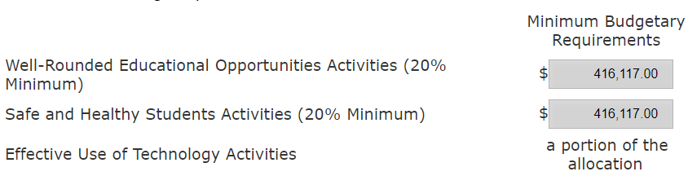
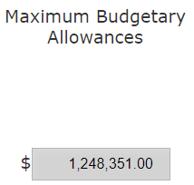
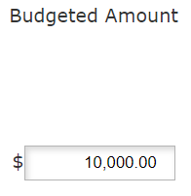
Budgeting Requirements in GMS

Slide 25

Schoolwide Programs
If you consolidate funds into the SWP, you must have at least one SWP investment that meets the intent of Title IV at each school where Title IV has been pooled
Schools | Pooled Title IV? | SWP investment?
Apple
Banana
Cherry

Slide 26
Schoolwide Programs
Title IV funds that have been consolidated into a Schoolwide Program “lose their identity” – as such, SWP investments that meet the intent of Title IV are not subject to Title IV budgeting requirements
Investments that meet the intent of Title IV in the SWP do not count toward budgeting requirements in Title IV

Slide 27
Writing a Title IV Investment
How do we get this approved?

Slide 28
Writing an Approvable Investment
Allowable
  It is supplemental to the basic education program?
  Does it meet the intent of the Title IV program?
  Allowable Uses Document
Necessary
  Supported by data representing a clear need?
  Comprehensive Needs Assessment/Data Inventory
Reasonable
  Would a prudent person pay this amount for this item?
  Provide details
Allocable
  Does it benefit the funding source?

Slide 29
Writing Investments
Provide a purpose
  What is the need that you are trying to meet?
  This should be more specific than stating one of the three content areas of the program
“In order to promote student knowledge of and interest in post-secondary opportunities,…”
NOT
“In order to provide a well-rounded education,…”

Slide 30
Writing Investments
Activity/strategy/intervention
  What activity will you implement to meet that need?

Slide 31
Writing Title IV Investments
How can you make it clear which intent you are trying to meet?
(And why is that important?)

Slide 32
Writing Title IV Investments
“Tag” the investment (WR, SH, EUT)
“EUT – In order to provide professional learning on the use of data and technology to support reading instruction, a consultant to provide 10 full days of data/implementation coaching sessions for up to 20 teachers and facilitate 5 after school follow up literacy coaching webinars for up to 6 staff (Scope of work attached).”

Slide 33
Writing Title IV Investments
2. Write both the intent and the purpose into the description
“In order to provide a safe and healthy learning environment by reducing exclusionary discipline and promoting supportive school discipline, 3 school-based teams (up to 6 participants) to attend 2 days of BEST/VTmtss Summer Institute”

Slide 34
Writing Title IV Investments
3. Upload additional documentation
Investment Number | Investment Description | Category
1 | Post-secondary options | Well-rounded
2 | BEST Institute | Safe & Healthy
3 | PD – supporting reading instruction | EUT – Non-infra
4 | Chromebooks | EUT – Infra

Slide 35
Writing Title IV Investments
Provide a clear purpose and activity
Ensure that the investment is allowable, reasonable, necessary
  Allowable uses document
  Data
  Provide details
Include information on the intended content area, if necessary
Reach out with questions

Slide 36
In closing…
THANK YOU
for your patience and flexibility!
Please reach out with questions
Katy.preston@vermont.gov

Slide 37

Questions?

