Slide 1
Spending CFP Funds
April 13, 2021

Slide 2

For today’s presentation…
Please mute your microphone
Please turn off your web cam
Ask questions in the chat box

Slide 3
Future Sessions & Resources
Final Session: Wednesday, April 14 – CFP Amendments
Resources and guidance referenced during this session can be found on the AOE website:
  Go to education.vermont.gov
  In the left-hand sidebar, click on
    “Student Support”
    “Federal Programs Under ESSA”
    “Consolidated Federal Programs”

Slide 4
Today’s topics
FY22 Spending
Title Program Overview
Statutory Flexibilities
Q&A

Slide 5
Spending Concerns
LEAs have faced an exceptionally challenging year and a half due to COVID
LEAs weren’t able to spend on many of the activities they had planned for a variety of reasons
Large influx of emergency funds that can be used for similar types of strategies
LEAs are carrying over extremely large amount of funds – a concern across all Titles
Potential of returned funds – indicates that we don’t have a need, public perception, less potential impact on staff and student needs

Slide 6
Title Programs

Slide 7
Titles I & II
Title I funds can support a wide range of activities to help Title I students meet state academic standards
  Instructional supports (do not have to be limited to reading and math)
  Non-academic services that impact student performance: school climate, behavior, social-emotional health, attendance
  Improving school quality
  Materials and/or technology to help engage with interventions/support those students most at risk
Title IIA funds can be used to provide supplemental activities that strengthen the quality and effectiveness of teachers, principals, and other school leaders
  Induction and mentoring
  Teacher leadership programs
  Instructional coaches
  Recruitment and retention efforts
  Development and implementation of evaluation and support systems
  Support for Early Learning Educators

Slide 8
Title IV
Title IVA funds can support a wide range of activities within the three content areas: well-rounded educational opportunities, safe and healthy students, and effective use of technology
Well-rounded: Social-emotional learning, flexible pathways, accelerated learning, multi-disciplinary approaches, college and career counseling, environmental education, drop out prevention activities, student engagement
Safe/Healthy: SEL/MH supports, healthy and active lifestyles, drop out prevention, integrated systems of student and family support, supportive school discipline practices, bullying and harassment prevention activities
Effective Use of Technology: Increasing capacity of educators to use technology in the classroom through PD/training; supporting personalized learning; technology to inform instruction/support teacher collaboration; building capacity and improving infrastructure

Slide 9
CFP Flexibilities

Slide 10
Title I Schoolwide Programs
Schools operating a Title I Schoolwide Program have flexibility to consolidate funds from Title I and other programs to better address the needs of students
  The school can implement a plan to upgrade the entire educational program of the school vs. more targeted approach
When funds are consolidated into a SWP, those funds lose their individual identity
  The school may use SWP funds to support any activity that meets the intent and purposes of each program whose funds are consolidated

Slide 11
Schoolwide Programs: Application Requirements
If a school consolidates and uses funds from another federal education program in a SWP, the school must be able to demonstrate that the SWP is meeting the intent and purposes of each program whose funds are consolidated
The SWP application must have at least one investment that meets the intent of the original funding source at each school where it has been pooled – no proportionality assigned to this
Required to be fully budgeted in SWP

Slide 12
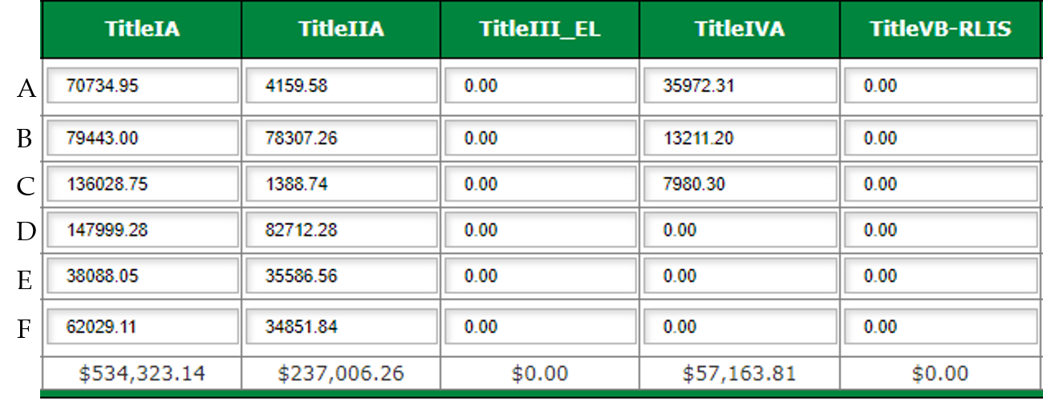
Schoolwide Programs

Slide 13
Consolidating Title IV into SWP
Once Title IV funds are consolidated in a schoolwide program, the consolidated funds no longer have to be tracked for specific compliance with the statutory budgeting requirements of Title IV—no distribution requirements in Schoolwide Programs
Title IV investments written in the Schoolwide Program do not count toward distribution requirements in the Title IV application
Example:
  Title IV allocation of $100,000
  Consolidate $75,000 Title IV funds → SWP
  Remaining Title IV funds: $25,000
    Must adhere to distribution requirements for an LEA receiving under $30,000 in Title IV

Slide 14
Consolidated Administration: Uses
ESSA allows LEAs to consolidate administrative funds from two or more programs into one pool
Allowable Uses:
  Administration of any consolidated program (oversight of grant programs)
    Research and development of the application
    Meeting assurances
    Planning for PD activities that are included in the grant as investments
    Reviewing implementation of and evaluation of CFP investments
    Supervision of staff paid for with CFP funds
    Audit costs and bookkeeping directly attributed to CFP grant activities

Slide 15
Consolidated Administration: Requirements
Requirements:
  Amount consolidated from each program does not exceed any statutory or regulatory cap on admin funds
  Funds are obligated within period of availability
  Activities for which funds are used are allowable
Statutory admin caps (including both direct and indirect administration)
  Title I: 10%
  Title II: 10%
  Title III: 2%
  Title IV: 2%
  Title V: 2%

Slide 16
Indirect
Indirect funds are earned on funds spent with an approved rate
  Apply for indirect rate by April 16, 2021
Be sure to pay attention to indirect costs during amendments
  If you add dollars to your budget for direct costs, please consider whether you can or want to add indirect dollars
  If you know that you are not going to be spending money on an investment previously approved, reduce the investment as much you can

Slide 17
Transferring CFP Funds
LEAs may transfer funds out of:
  Title IIA
  Title IVA
LEAs may transfer funds into:
  Title IA
  Title IIA
  Title IIIA*
  Title IVA
  Title VB (Rural Education)*
*An LEA may not transfer funds into a program in which it did not receive an allocation

Slide 18
Transfers: Requirements
LEA must engage in timely and meaningful consultation with appropriate independent schools
Data inventory must be updated to reflect the unique need that precipitated the transfer
LEA must notify VT-AOE of intent to transfer funds at least 30 days prior to submission of application or amendment in which transfer appears
Notice of Transfer form
  Send to Karen Abbott

Slide 19
FY22 Waivers

Slide 20
Title I Carryover
LEAs may not carry over more than 15% of the previous year’s Title I allocation
ESSA allows LEAs to apply to the SEA for a waiver of this limit once every 3 years
EdFlex authority allows VT-AOE to waive this limit a second time in a 3-year period

Slide 21
Title I Carryover Waiver Process
The LEA must identify specific, needs-based activities towards which to obligate the entirety of Title I funds in the CFP application
The LEA must have in place specific documented procedures to prevent excess Title I carryover in the future

Slide 22
Title I Carryover Waiver
VT-AOE received a waiver from US DOE allowing all LEAs to apply for 15% carryover waiver for FY21, regardless of the number of waivers granted to an LEA in the past 3 years
No indication from US DOE that there will be another blanket waiver for FY22 – reverting to the regular Title I Carryover Waiver process:
  No more than 15% carryover
  LEAs can apply for a waiver once every three years
  LEAs can apply for a waiver a second time in 3 years under EdFlex authority
Those with two or more waivers in the last three years will not be eligible for to apply for a waiver in FY22
If you’re not sure how many waivers your LEA has, please contact Kristine Seipel

Slide 23
Title I Eligibility Waiver
In order for a school to be served under Title I it must meet at least one of the following criteria (§1113):
  The school must serve a student population with at least 35% qualifying as low-income; or
  The percentage of students who are low-income must be at or above the LEA average for all schools; or
  The percentage of students who are low-income must be at or above the LEA average for schools serving the same grade span.
Under Ed-Flex authority, VT-AOE is able to waive eligibility requirements for a school that meets the following:
  The rate of students who are low-income is not more than ten percentage points below that of a Title I-eligible school in the LEA, not including those eligible by grandfathering

Slide 24
Title I Eligibility Example
School | Low-Income % | Served | Within 10% | Eligible for Waiver
Apple | 28.2% | Yes
Walnut | 21.5% | Yes
Maple | 14.3% |  | Yes | Yes
Oak | 13.3% |  | Yes | Yes
Cherry | 10.8% |  | No | No
Low Income Average of the LEA: 17.6%

Slide 25
Title I Eligibility Waiver Process
If applying for multiple schools, submit individual waiver request for each school
The LEA must submit a Data Inventory that meets all Title I requirements
The LEA must ensure that all requirements of schools operating a Title I program are met, including PFE requirements
Waiver Request narrative responses:
  How the Title I program will meet the specific needs of students most at risk to not meet state standards
  Criteria school will use to identify students to receive services
  How the LEA will ensure the needs of students in currently served schools will continue to be met
Submit to Kristine Seipel prior to submission of CFP application (rolling deadline)
Approved waivers are good for a 1-year period

Slide 26
Title I Schoolwide Waiver
LEAs may serve a Title I eligible school as a Schoolwide Program if that school serves a low-income student population of at least 40% (ESSA §1114)
ESSA permits SEAs to waive the 40% low-income threshold
If a school does not meet the 40% threshold, the LEA may complete a waiver request on the school’s behalf
The LEA and school are responsible for meeting all other ESSA requirements for operating a Title I Schoolwide Program

Slide 27
Schoolwide Waiver Process
If applying for multiple schools, submit individual waiver request for each school
School must complete a SWP needs assessment
School must have a current SWP Plan that meets all requirements
School must engage in consultation with broad range of stakeholders
Waiver Request narrative responses:
  Describe need and rationale for the waiver
  Describe how the school will continue to meet the specific needs of its most at-risk students
Submit to Kristine Seipel prior to submission of CFP application (rolling deadline)
Approved waivers are good for a 3-year period

Slide 28
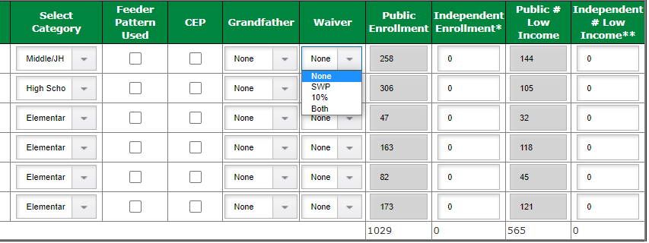
Title I Waivers in GMS
SWP – Schoolwide Program Waiver
10% - Title I Eligibility Waiver

Slide 29
Title IV Waiver Process
SEA waiver request to US DOE under ESSA §8401(b) – blanket waiver
  Submitted to DOE on 3/23
If approved, blanket waiver will apply to all LEAs – no need to apply individually
If not approved by US DOE prior to application opening, LEAs can apply individually to AOE (EdFlex) – submit to Katy Preston
  Purpose and expected results of waiving the requirements
  LEA’s specific measurable goals related to the intents of Title IVA
  Why the waiver will assist in reaching those goals
  How the LEA will provide public notice and opportunity for comment

Slide 30
Title IV Waiver
Waives the Title IV budgeting requirements
  20%, 20%, and a “portion of”
  15% infrastructure cap (Effective Use of Technology)
Activities still need to be distributed across the three content areas:
  Allocation of $30,000 or more – must write at least one investment in each content area
  Less than $30,000 – must write an investment in at least one content area
Need to provide support for strategies in the Data Inventory
Need to indicate in the application which content area the investment falls under – data collection purposes
  Changes on Budget Allocation tab

Slide 31
Title IV Waiver Example
Title IV allocation $100,000
Example: no waiver
  Well-rounded (at least 20%) – investments totaling $30,000
  Safe/heathy (at least 20%) – investments totaling $50,000
  Effective Use of Technology (portion of) – investments totaling $10,000
    Tech Infrastructure (no more than 15% of amount budgeted for EUT) – investments totaling $1,500
Example: waiver enacted
  Well-rounded – investments totaling $5,000
  Safe/Healthy – investments totaling $75,000
  Effective Use of Technology – investments totaling $10,000
    Tech Infrastructure – investments totaling $7,000

Slide 32
Resources
Waivers (email)
  Title I Carryover Waiver Application
  Title I Eligibility Waiver Application
  Title I SWP Waiver Application
  Title IV Waiver Application
Allowable Uses Documents (CFP website)
  Title I
  Title II
  Title III
  Title IV
  ConAdmin
Schoolwide Programs Non-Regulatory Guidance (CFP website)
Notice of Transfer form (CFP website)

Slide 33
Who to Contact
Questions about…
Title I – Kristine Seipel (kristine.seipel@vermont.gov)
  Schoolwide Programs
  Title I Carryover Waiver
  Title I Eligibility (10%) Waiver
  Title I Schoolwide Waiver
Title II – Megan Kinlock (megan.kinlock@vermont.gov)
Title III – Jim McCobb (james.mccobb@vermont.gov)
Title IV – Katy Preston (katy.preston@vermont.gov)
  Title IV Waiver
Consolidated Administration & Transferring funds – Karen Abbott (karen.abbott@vermont.gov)

Slide 34

Questions?

