Slide 1
Best Interest Determinations
&
Dispute Resolution
August 2020
Vermont Education for Homeless Children & Youth

Slide 2
For today’s presentation…
Please mute your microphone
Please turn off your web cam
Feel free to ask questions in the chat box
This session will be recorded and posted to the website:
  https://education.vermont.gov/student-support/federal-programs/homeless-education

Slide 3
Today’s topics
Review
  McKinney-Vento Definition of Homelessness
  School of origin & local attendance area school
Determining Best Interest
  Student rights & LEA requirements
  Strategies & questions to ask
Dispute Resolution Process

Slide 4
McKinney-Vento Definition & School Selection Rights

Slide 5
McKinney-Vento Definition of Homeless
Children or youth who lack a fixed, regular, and adequate nighttime residence, including children and youth:
  Sharing the housing of other persons due to loss of housing, economic hardship, or a similar reason
  Living in motels, hotels, trailer parks, or camping grounds due to the lack of alternative adequate accommodations
  Living in emergency or transitional shelters, or are abandoned in hospitals
  Living in a public or private place, not designed for or ordinarily used as regular sleeping accommodation for human beings
  Living in cars, parks, public spaces, abandoned buildings, substandard housing, bus or train stations, or similar settings
  Migratory children living in the above circumstances

Slide 6

Example
It’s August and the Moore family is trying to enroll their daughter in your school. Their daughter, Stephanie, is entering 7th grade. The family explains that they have been living in a shelter since May. The family is still in the shelter and is not sure when they will be able to get permanent housing.
Is Stephanie eligible for McKinney-Vento?
Living in a shelter
Notes:
**Examples provided in the presentation are specific to the context of this training. All McKinney-Vento eligibility determinations are made on a case-by-case basis**

Slide 7
School of Origin
The school that a child or youth attended when permanently housed,
or
The school in which the child or youth was last enrolled

Slide 8
School of Local Attendance Area
Any public school that non-homeless students who live in the attendance area in which the child or youth is actually living are eligible to attend

Slide 9
Example
The Moore family continued:
Mr. Moore explains that Stephanie was able to stay in her elementary school last year under McKinney-Vento, even though the shelter where they are staying is in a different district. She has completed the final grade in her elementary school and her parents would like her to continue into 7th grade with her peers. That school is also not within the attendance area of the shelter.
Where can Stephanie enroll?
School of origin definition includes receiving schools, so the middle school that is receiving students from Stephanie’s elementary school is an option
School of local attendance area: school that serves the attendance area of the shelter
Notes:
**Examples provided in the presentation are specific to the context of this training. All McKinney-Vento best interest determinations are made on a case-by-case basis**

Slide 10
Duration of Rights
Homeless children and youth have the right to attend the school of origin for the duration of homelessness
  In any case in which a family becomes homeless between academic years or during an academic year
  For the remainder of the academic year, if the child or youth becomes permanently housed during an academic year

Slide 11
Example
The Moore family continued:
Stephanie is enrolled in 7th grade at her school of origin, with the LEA providing transportation to and from the school. It’s now October and you find out that the Moore family has secured an apartment and is now permanently housed.
Can Stephanie remain in her school of origin? For how long?
Stephanie remains eligible for all McKinney-Vento services until the end of the academic year in which she became permanently housed – she can remain in her school of origin until the end of the school year
Notes:
**Examples provided in the presentation are specific to the context of this training. All McKinney-Vento best interest determinations are made on a case-by-case basis**

Slide 12
School Placement
LEAs must make school placement determinations based on the “best interest” of the homeless child or youth
Using this standard of best interest, LEAs must:
  Continue the child’s or youth’s education in the school of origin
  Enroll the child or youth in the local attendance area school

Slide 13
School of Origin & Best Interest
The law assumes that keeping a student in the school of origin is in the best interest of the student
The LEA must, to the extent feasible, keep a student experiencing homelessness in the school of origin, unless it is against the wishes of the parent/guardian or unaccompanied youth

Slide 14
“…to the extent feasible…”
What should be considered when determining the extent to which it is feasible to educate a child or youth experiencing homelessness in the school of origin?
  Student-centered, individualized factors related to the child’s or youth’s best interest
  These can include factors related to the impact of mobility on:
    Achievement
    Education
    Health
    Safety

Slide 15
Factors to Consider
Factors must be student-centered and individualized
  Student’s age
  Distance of the commute/impact on student’s education
  Safety concerns
  Student’s need for special instruction
  Length of anticipated stay in a temporary shelter
  Time remaining in the school year
  Placement of siblings

Slide 16
Special Considerations for Preschool-age Children
School and program stability is critically important for this particularly vulnerable population
LEAs may consider the following additional factors for preschool-age children:
  Child’s attachment to preschool teachers & staff
  Impact of school climate on the child, including the school’s safety
  Availability and quality of services to meet the child’s comprehensive needs
    Access to early childhood mental health consultants
  Travel time to and from school

Slide 17
Role of Liaison
Ensure that homeless parents/guardians and youth understand all school selection options
Reinforce the important of school stability and educational continuity
Discuss with the parents/guardians or youth their unique circumstances
Assist them with making the most appropriate choice

Slide 18
Questions to Consider
Are there safety issues to consider?
How permanent does the family’s current living arrangement appear to be?
How deep are the student’s ties to the current school?
How strong is the child academically?
How anxious does the student seem about the transition?
How do the programs/activities offered at the schools compare?
How would the length of the commute to the school of origin impact the student’s education?

Slide 19
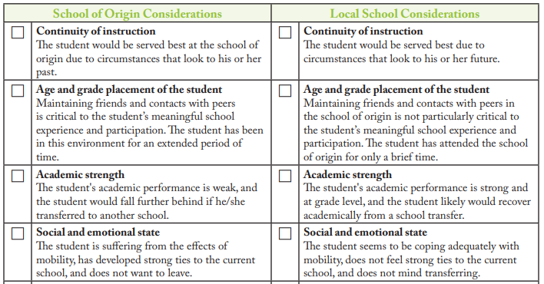
Guiding the Conversation

Slide 20
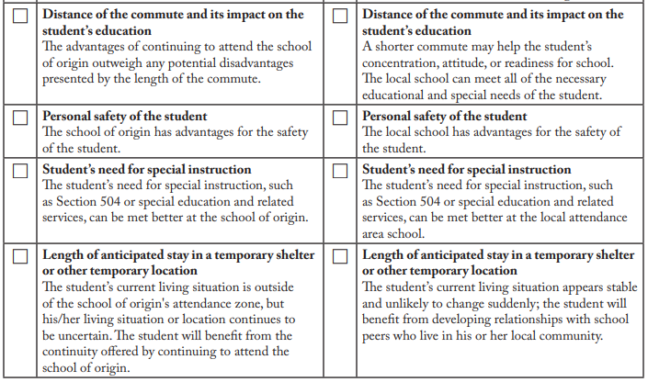

Slide 21
Determining Best Interest
In determining best interest, the LEA must:
  Presume that keeping the student in the school of origin is in the student’s best interest
  Consider student-centered factors, including the impact of mobility on achievement, education, health, and safety
  Give priority to the request of the parent/guardian or unaccompanied youth

Slide 22
Best Interest Determination
If, after conducting the best interest determination, the liaison determines that it is in the student’s best interest to attend the school of origin:
  The LEA must provide transportation as requested by the parent/guardian or unaccompanied youth
If, after conducting the best interest determination, the liaison determines that it is in the student’s best interest to attend the local school:
  The local liaison should work with the liaison in that LEA to facilitate the transfer of records, etc.

Slide 23
Best Interest Determination
If, after conducting the best interest determination, the local liaison determines that it is not in the student’s best interest to attend the school of origin or the school requested by the parent, guardian, or unaccompanied youth, the LEA must provide:
  written explanation of the reasons for its determination
  information regarding the right to appeal the decision

Slide 24

Questions?

Slide 25
Dispute Resolution

Slide 26
Dispute Resolution Procedure
Every State must have a procedure for the prompt resolution of disputes
Intended to represent each party’s view for objective consideration so disagreements can be solved quickly and in accordance with the McKinney-Vento Act
Some LEAs may also have their own written policy for resolving disputes at the local level – must be consistent with the State dispute resolution policy
SEA Appeal Procedure

Slide 27
Dispute Resolution
If a dispute arises over eligibility, school selection or enrollment:
  The student must immediately be enrolled in the school in which enrollment is sought, pending final resolution of the dispute, including all available appeals
    Students have the right to participate fully in school
    Students must receive all services for which they are eligible
    Students must receive transportation, as needed, to and from the school of origin
  The parent, guardian, or unaccompanied youth must be provided with a written explanation of :
    any decision related to the dispute
    the rights of the parent, guardian, or unaccompanied youth to appeal the decision

Slide 28
Written Notification & Rights to Appeal
Parents/guardians or youth must be provided with a written explanation of any decisions related to eligibility, or school selection or enrollment made by the LEA or SEA
Explanation about the reason for the decision should include (USED Non-Regs):
  Description of the action that is proposed or refused
  Explanation of why the action is being proposed or refused
  A description of any other options the school considered
  The reasons these other options were rejected
  A description of any other factors relevant to the school’s decision and information related to the eligibility or best interest determination including the facts, witnesses, and evidence relied upon
Rights to appeal & relevant timelines
Contact information for local liaison & State Coordinator
https://nche.ed.gov/homeless-liaison-toolkit/

Slide 29
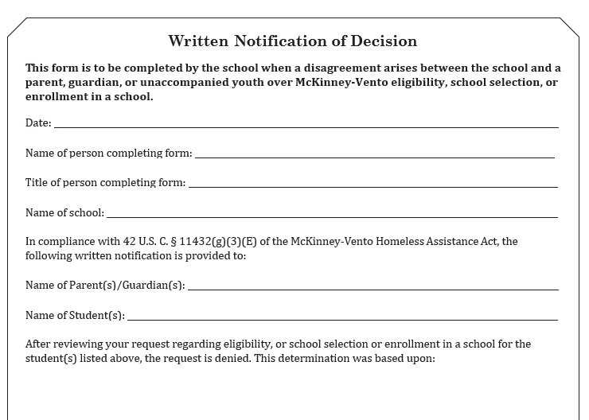
Written Notification to Parents

Slide 30
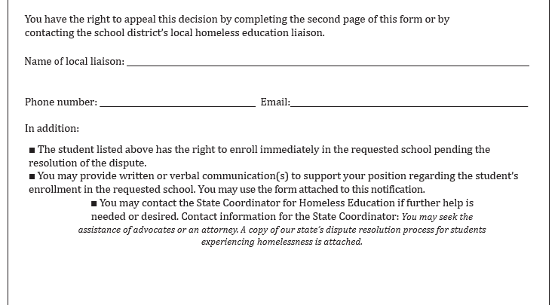
Written Notification to Parents

Slide 31
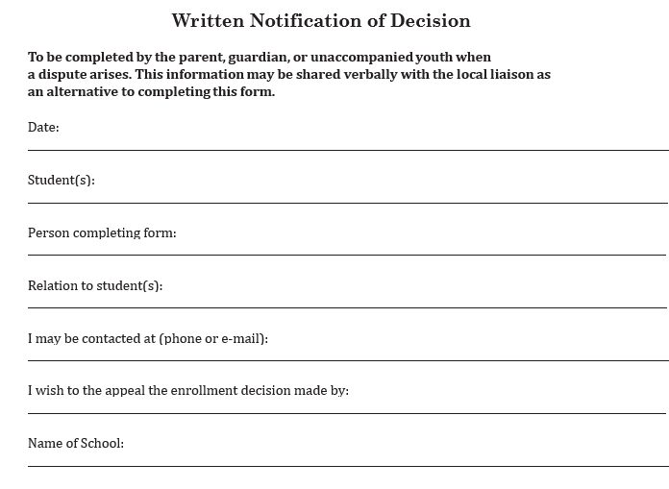
Written Notification of Decision

Slide 32
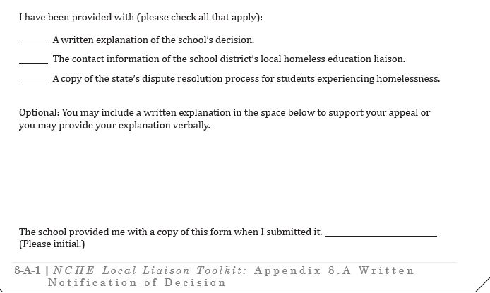
Written Notification of Decision

Slide 33
Dispute Process
Ensure that any written notice:
  Includes all relevant information
  Is as brief and simply stated as possible
  Is accessible/written in a manner understandable to all parents/guardians or youth
Ensure that the dispute process is as informal and accessible as possible while allowing impartial and complete review
Parents should be able to initiate the dispute process directly at the school, as well as directly with the liaison
If parents or youth have access to email, the LEA should provide notices by email, followed by written notice in person or by mail

Slide 34
Vermont Dispute Resolution Process

Slide 35
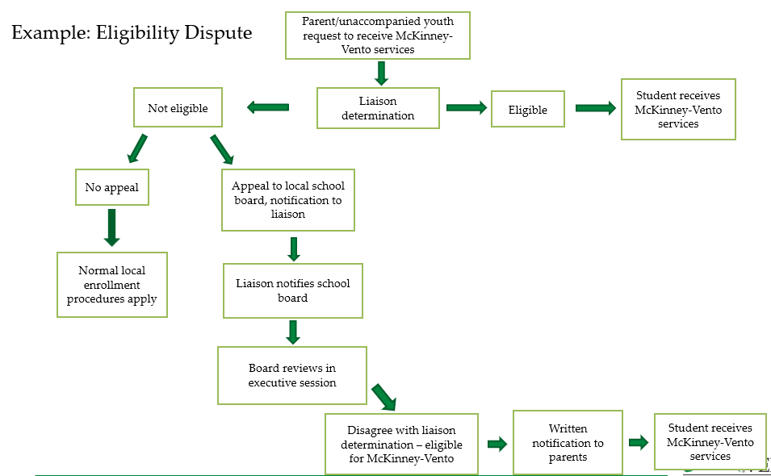

Slide 36
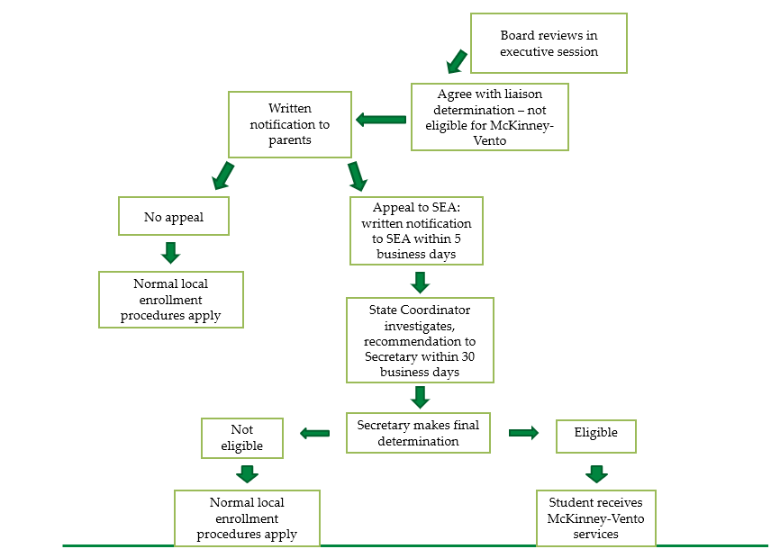

Slide 37
SEA-Level Appeals
Timelines:
  5 days after written notification from the school board to appeal to the SEA
  SEA will provide a written receipt within 10 days to the family/youth and the superintendent
  30 days to investigate and make recommendation to Secretary
  If extension is needed, all parties will be notified
Appeals can be either emailed or mailed
Appeals should be addressed to the Secretary of Education (can be mailed/emailed to SC)
Any communication during the dispute should include all parties

Slide 38
LEA Strategies
Provide parents/youth with assistance in the dispute process:
  Ensure that they understand the dispute resolution timeline/deadlines
  Offer to assist in gathering information
  Minimize inconvenience
Gather information respectfully and in accordance with FERPA
Keep documentation of all dispute-related communications
Ensure that the student is enrolled and fully participating in the school selected for the duration of the dispute process
Follow up with the parent/guardian/youth and the involved school after the decision to assist with implementation, as needed
Notes:
-LEAs may want to have a written dispute procedure – must be in line with the SEAs procedure in order to ensure consistency between LEAs

Slide 39
LEA Strategies
Strategies to avoid disputes:
  Training the appropriate school staff on the McKinney-Vento Act
  Communicating in person with parents, guardians, and/or youth
  Training staff on trauma-informed approaches to working with families and youth in homeless situations

Slide 40
Questions

Slide 41
Who to Contact
Katy Preston, State Coordinator for Homeless Education, katy.preston@vermont.gov
Other resources:
  National Center for Homeless Education (NCHE)
  SchoolHouse Connection

