Slide 1
CFP Grants Management
April 21, 2020

Slide 2

Technology Stuff
Please mute your microphone
Please turn off your web cam
Ask questions in the chat function
Sessions will be recorded and posted

Slide 3
Session Resources
This document, as well as resources, templates and guidance referenced during sessions, can be found on the AOE website:
  Go to education.vermont.gov
  In the left-hand sidebar, click on
    “Student Support”
    “Federal Programs Under ESSA”
    “Consolidated Federal Programs”

Slide 4
Thank You
  We appreciate your flexibility, patience, hard work, honesty, humor and colleagueship.

Slide 5
Topics for Today’s Session
Lessons Learned
Getting Started: Odds and Ends
Writing and Budgeting Investments
Fiscal Considerations
Who Should I Contact

Slide 6

Lessons Learned
This application relies on the essential relationship between the CFP Team Leader and the Business Office
Notes:
Admin errors as a result of the 1st year system will be disallowed this year.
Make sure the codes are correct and the business manager reviews before submission
FY20 the GMS will have a business manager sign off

Slide 7
Getting Started: Odds and Ends

Slide 8
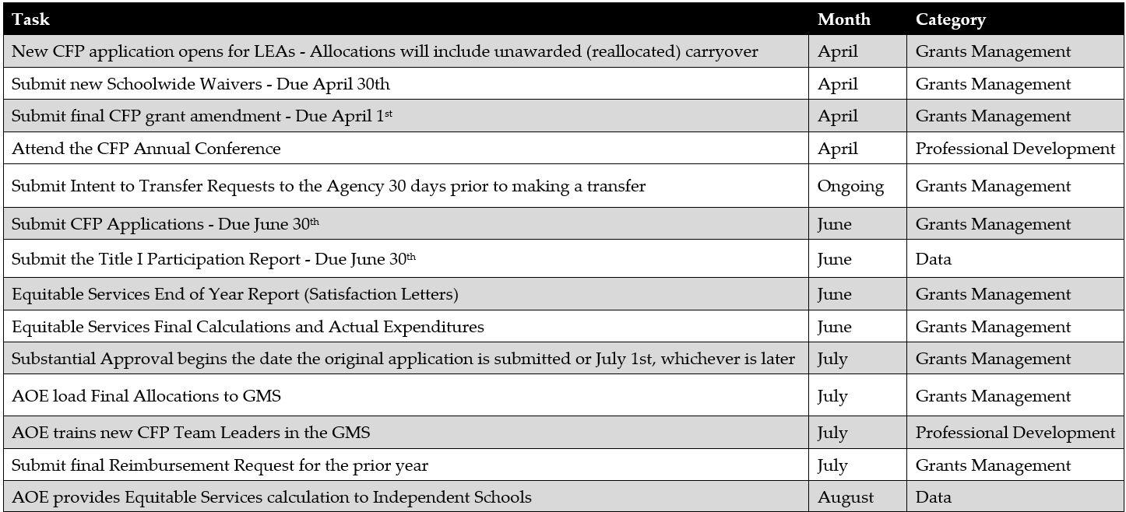
CFP Timeline

Slide 9
CFP Timeline
These are best case scenarios deadlines
The timeline includes 4 types of activities – Grants Management, Professional Development, Monitoring and Data Requests
In addition, it includes when you can expect information from us
A tool to help you plan for the upcoming year

Slide 10
Transfers
You may transfer up to 100% of the LEA’s Title II and/or Title IV Allocation to Title I, II, III, IV or V.
The LEA must submit Intent to Transfer Requests to the Agency 30 days prior to making a transfer.
Does not apply to consolidated funds such as SWP, Consolidated Admin, or REAP.

Slide 11
Targeting & Ranking (T & R)
New Draft T&R Non-Regulatory Guidance
T & R is unique to your LEA. Please continue to reach out with specific questions.
Notes:
Title I funds only

Slide 12
Grant Awards and Amendments
Grant Type | Examples | Period of Performance Starts
Federal Formula Grants | Title I, IIA, IV, IDEA, etc. | The later of either the date of substantial approval or July 1
Discretionary Federal Grants | 21C | the date the Secretary of Education signs the grant award
State Grants | Tobacco, Act 230, BEST | the date the Secretary of Education signs the grant award
Amendments | All Grant types and funding sources | the date the Secretary of Education signs the amended grant award

Slide 13
Monitoring
Two types of CFP Monitoring occurs each year
CFP Onsite Monitoring
All CFP areas are addressed
Focus Monitoring
Typically conducted as a desk audit
Areas of focus are based on technical assistance requested from the field and CFP assurances

Slide 14
CFP Assurances
Distribute a copy of the CFP assurances to all administrators in the LEA by September.
Remember it is your responsiblity for knowing what you’ve committed to.
Make sure to keep all documentation that relates to the assurances. You may be asked to provide this information during a CFP Onsite or Focus Monitoring.

Slide 15
Writing and Budgeting Investments

Slide 16
Common Application Needs
Investment purposes are not supported by data
Investment descriptions feature too few details to determine reasonableness
Minimum budgeting or set-aside requirements are not met, particularly after an increase in allocations
Budget details are incorrect
Not all application feedback has been addressed

Slide 17
Investment Descriptions
Include specific, data-aligned statements of purpose.
Include specific activities, strategies or investments.
No longer include cost categories (e.g. “salary, benefits, travel and materials”).
Investment descriptions should be specific enough to make the appropriateness of each budget line item clear

Slide 18
Budget Details
Each budget detail must include a brief, but clear, description of the expenditure (“registration fee” or “salary”).
Collaborate with the business office
Consult the UCOA guidance for questions regarding object and function codes
Include benefits for any investment that includes salaries or stipends
Notes:
This description will usually be 3-6 words long, describing exactly what will be paid for by that line item.
Work collaboratively with the business office to ensure that all costs are included in the budget details and are aligned to the correct object and function codes

Slide 19
Budget Details
Please:
Do not write expenditure descriptions by cutting and pasting the investment description
Do not group costs that are different object codes
Do not use Object Code 730 for supplies that are valued less than $5000 per unit
Do not write separate line items for retirement (include in Object Code 200 with the other benefits)
Notes:
Work collaboratively with the business office to ensure that all costs are included in the budget details and are aligned to the correct object and function codes

Slide 20
Fiscal Considerations

Slide 21
35% Flexibility
The AOE made a change in the methodology for calculating this budget flexibility for FY19 that will continue in FY21
  the percentage is 35%
  this is applied to the object code roll-up level not the grant award amount
  The 35% flexibility is only applicable if the overspending is due to a budget estimating issue. A change in the “what” always requires an amendment.
  You can never exceed the total grant award amount.
Notes:
In the past, the AOE has allowed subgrantees to overspend an investment line item up to 10% of the grant award amount (without an amendment) as long as the increase did not represent a change to the “what”
Remember, you can never exceed the total grant award amount, so if you use the flexibility to increase the amount in one investment you will need to be under in another investment.
The 35% flexibility resets upon amendment (for amended object roll-ups)

Slide 22

Example 1
Grant award budget is approved for a .5 FTE teacher at a cost of $35,000 for salary and $8,000 for benefits. When budgeted the LEA used a single person health plan to estimate the cost, but the person hired chooses a family plan at a cost of $10,000. The increase is under 35% of the object code roll-up for the same “what” - a .5FTE teacher.
*Example is simplified and assumes no other
benefits costs are rolled-up to the object code.

Slide 23

Example 2
Grant award budget is approved to send 2 teachers to a PD conference at an estimated cost of $1,000 each for a total of $2,000. Other spending of the grant award has been under budgeted amounts resulting in “available” grant dollars so the LEA decides to send 10 teachers for a total of $10,000.
The percentage over the original budget is irrelevant because the “what” has changed. The 35% flexibility does not apply and an amendment is required.

Slide 24
Subgrants
LEAs may only subgrant funds passed through the AOE to its member districts.
This is when the grant is received at the SU level, but obligations are incurred at a district level
Requires an official subgrant document signed by the Superintendent and Principal
The correct coding for funds that are subgranted is
  Object Code 800
  Function Code 5510
Notes:
Check yes on the investment page if a portion of the investment is subgranted to a member school district
In the budget detail, subgrants must be coded to object code 800
Object code 800 will not be excluded from indirect

Slide 25
Administration Caps for the Title Funds
Title I, Title II – 10%
Title III, IV, V – 2%
Admin caps include both direct and indirect administration
In the Con Admin budget all budget line items must be coded to Function Code 2495 (Administration of Grants)
Note: In the title specific budget(s) the LEA must use function code 9995 (Con Admin)

Slide 26
Indirect Costs on Amendments
Make sure to pay attention to your indirect costs during amendments
  If you add dollars to your budget for direct costs please consider whether you can or want to add indirect dollars.
  If you know that you are not going to be spending $ on an investment previously approved – reduce the investment as much you can.

Slide 27
Contractor vs Employee
During application budget development it can be difficult to determine if the work you are accomplishing will be done by a contractor or an employee
GMS system requires you to code at the object code level – making you choose between
  Object Code100 for salary or;
  Object Code 300 for professional services

Slide 28
Contractor vs Employee
It is important to remember that the grant budget authorizes and restricts your grant spending.
If you choose to hire an employee (100) and you end up with a contractor (300) or vice versa, you must amend your application and receive approval prior to incurring the obligation.
By changing the object code you are changing the “what”
The same would apply to circumstances involving equipment vs. supplies.

Slide 29
You’re in Control
October 1 Census Data
The enrollment and FRL data that your LEA submits through the October 1 Census count drives Title I eligibility.
September 30th AOE 3.0
Calculating and notifying LEAs of excess Title I carryforward depends on submitting, as does reallocation of these funds.
Amendments
LEA can create an amendment once the Grant Award Notification (GAN) is generated and Closeout Reports are approved.

Slide 30
Who Should I Contact?

Slide 31
CFP Application Contacts
NAME | Title | e-mail | Number
Jesse Roy | FESP Assistant Division Director | jesse.roy@vermont.gov | 802-828-1390
Kristine Seipel | Title I State Director | kristine.seipel@vermont.gov | 802-828-1447
Amber Graves | Title I Consultant | amber.graves@vermont.gov | 802-828-5493
Megan Kinlock | Title II & Migrant State Director | megan.kinlock@vermont.gov | 802-828-1472
Jim McCobb | Title III State Director | james.mccobb@vermont.gov | 802-828-1533
Katy Preston | Title IV & Homeless Ed. State Director | katy.preston@vermont.gov | 802-828-1468
Karen Abbott | CFP Grants Management Specialist | karen.abbott@vermont.gov | 802-828-4370

Slide 32
Finance and Fiscal Monitoring Contacts
Name | Title | e-mail | Number
John Leu | Financial Administrator | John.leu@vermont.gov | 802-828-4363
Bob Coathup | School Finance Analyst | Robert.coathup@vermont.gov | 802-828-4089
Abby Houle | School Finance Analyst | Abby.houle@vermont.gov | 802-828-4047

Slide 33
Education Quality Assurance Contacts
Name | title | e-mail | Number
Josh Souliere | EQA Assistant Division Director | Josh.souliere@vermont.gov | 802-828-0790
Marianne Charalabopoulos | EQA Coordinator | Marianna.Charalabopoulos@vermont.gov | 802-828-1199
Jenn Dale | EQA Coordinator | Jenn.dale@vermont.gov | 802-828-1290
Kevin Doering | EQA Coordinator | Kevin.doering@vermont.gov | 802-828-1192
Toni Marra | EQA Coordinator | Toni.marra@vermont.gov | 802-282-1206

Slide 34
GMS Helpdesk
Name | title | e-mail | Number
AOE Help Desk |  | AOE.GMSHelp@vermont.gov | 802-828-1017

Slide 35


Slide 36
Contact Information
Karen Abbott, CFP Grants Management Specialist
(802) 479-1370 - work
(802) 595-0167 - cell
karen.abbott@vermont.gov

