Slide 1

Consolidated Federal Accounting with UCOA and E-Finance
Schoolwide Program (SWP) and
Consolidated Administration (Con Admin)
April 22, 2020
Bob Coathup, School Finance Analyst II
robert.coathup@vermont.gov
802-828-4089

Slide 2
Before we start:
Please mute your microphone
Please turn off your web cam
Feel free to ask questions in the chat function
Sessions will be recorded and posted

Slide 3
What are Consolidated Funds?
Consolidated Funds include:
  Consolidated Administration (Con. Admin.)
  Schoolwide Program (SWP)

Slide 4
Things to Know About Consolidated Funds
Consolidated funds support an activity without regard to which program contributed the specific funds used for a particular activity.
Increase flexibility
Single Cost Objective for time and effort
Business office will set up consolidated accounting records and direct charge SWP expenses accordingly.

Slide 5
Consolidated Administration
“Con Admin”
Allows you to pay for “Administration” tasks without having to track the costs to each funding source.
Must combine some funds from all Federal grants benefitting from the administration services.
Con Admin expenditures are included in the administration caps for each grant.

Slide 6
Schoolwide
School must be approved to participate in Schoolwide
Low income % requirements
Requires a Schoolwide Plan
Allows the LEA to serve all students vs. a target assistance approach
All Schoolwide expenses must be “building based”
Schoolwide Plan as a whole must address the intent and purpose of each of the Federal programs included in the consolidated pool of funds.

Slide 7
Types of Schoolwide (SWP)
There are three (3) types of Schoolwide Models:
SW1—Title I funds only - still requires separate accounting record
SW2—Consolidation of Title I funds+ one or more other federal funds
SW3—Consolidation of Title I funds, other Federal funds, and state / local funds

Slide 8
Examples of Funds That Can Be Consolidated in SWP
Title I
Title IIA
Title III (with conditions)
Title IV Part A
IDEAB
  The amount of funds that can be consolidated are the total IDEA-B allocation for the year divided by the number of children with disabilities in the SU/SD multiplied by the number of students with disabilities in the school
21st Century, Title IV, Part B
State/Local

Slide 9
What Must the Accounting Structure for SWP and Con Admin Accomplish?
Must allow the contributing funds to lose their source identity and restrictions
Must provide detail to support grant funds were spent on allowable expenditures
Must be able to report back to the VT AOE under the contributing title(s) i.e. Title I and Title IIA, Title IV, IDEA etc.

Slide 10
Accounting Structure for Consolidated Accounts: (SWP and Con. Admin.)
LEA must create a separate accounting record for each consolidated account to track associated expenditures and cost data.
  One record for each SWP school
  One record for Con. Admin
Expenditures must be charged directly to “consolidated fund” accounting record.

Slide 11
Good News
With the Uniform Chart of Accounts and the E-Finance accounting software, the AOE can now provide better instructions for LEAs to account for SWP and Con Admin funds.

Slide 12
E-Finance Accounting Structure

Slide 13
Uniform Chart of Accounts (UCOA)
With E-Finance, the important sections of the accounting structure for Identifying SWP accounting are, but not limited to:
  Subgrant Fund called School-wide Program (SWP)
  Location Code to use to identify the school-building base
  Function code
  Type Object code
  Type Revenue code
If a LEA is not on E-Finance, the sections above are important in your accounting structure.

Slide 14
SWP Accounting using E-Finance
Example: LEA with Con Admin and three schools:
Need to set-up 6 budgets as approved in the grant award.
  The items below are for the new UCOA
Name: | Fund Code: | Location Code:
Title 1A | 2106 | 401
Title IIA | 2125 | 401
Con Admin | 2598 | 401
SWP – School 1 | 2599 | 201
SWP – School 2 | 2599 | 202
SWP – School 3 | 2599 | 203

Slide 15
Consolidated Funds Reporting:
How to claim the expenditures for reimbursement?
While you account for the expenditures as SWP, in order to claim reimbursement, you must report expenditures on the AOE 3.0s by funding source.
Because, you are not required to track SWP expenditures to a specific program source you have two options for reporting: (choice made on CFP application at beginning of year)
  Sequential
  Prorated
Must continue with one method for the entire grant award.
Program staff and business office staff should review funding positions annually before determining the method of reporting to be sure it uses the most advantageous method.

Slide 16
Sequential
Funds are paid from a single funding source until that source is exhausted, and then remaining payments are paid from the next funding source and so on.
  Things to remember:
    SWP –2: Title I will always draw first, but LEA determines the order of funds after Title I.
    SWP-3: State/local will draw first, Title I second, LEA chooses order of other Federal funds.

Slide 17
Prorated
Funds are drawn from each source at a rate proportional to the amounts consolidated across all funding sources.
Example: Total SWP fund of $100K is made up of $80K Title I and $20K Title IIA. Each expenditure is reported on AOE 3.0s as
80% of expenditure to Title I
20% of expenditure to Title IIA.

Slide 18
SWP Accounting
Examples of the SWP Accounting using the new Uniform Chart of Accounts (UCOA) are mention in the new Handbook II that is on the Agency of Education website:
Handbook II

Slide 19
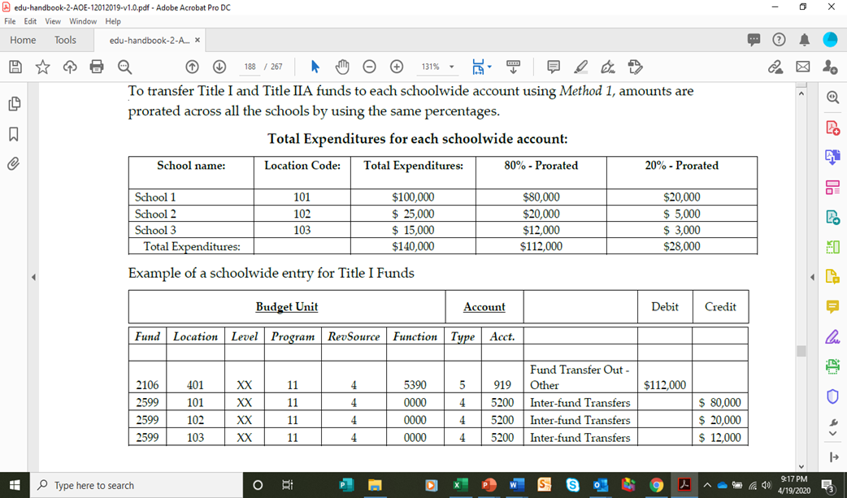

Slide 20
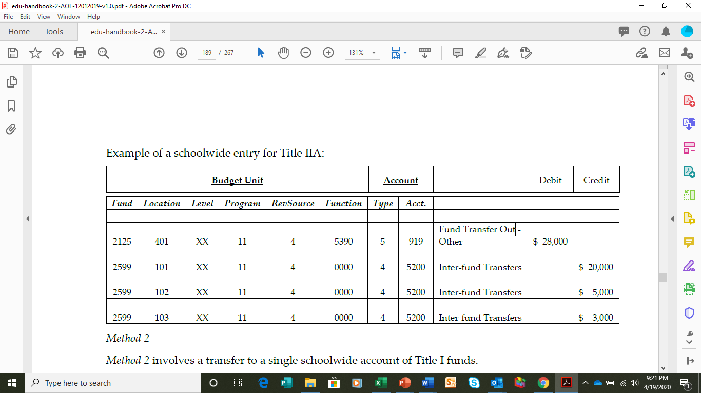

Slide 21
Reporting on an AOE 3.0; Expenditures Reimbursement Request in GMS-MTW
After moving the School-wide expenditures to the right funding source by using Sequential of Prorated method:
  On the Reimbursement Request Form (AOE 3.0)
    Enter the amount for Con Admin (#995) in the text box on the form
    Enter the amount for SWP (#990) expenditures in the text box on the form.
      The agency is working with GMS to have those numbers change to words for FY22.

Slide 22
Federal Fiscal & Compliance
Monitoring Visit
During Each Fiscal Year, A group of two or more AOE Staff Members will completed a Fiscal and Compliance Monitoring Visit
The next few slides will show the most common errors we find in the field

Slide 23
Most Common Missing Documentation
No Purchase Order per local procedures
No procurement documentation / SAM
No stipend agreements / time and effort
No contract (vendor)
No itemized receipt
No purpose of trip / inadequate description (mileage)
No packing slip / order confirmation
No sign-in sheet/agenda for family/parental engagement
No pre-approval for PD per local procedures
No proof of attendance for PD
No agenda for PD
No sign-in sheets for on-site PD

Slide 24
Examples of Contract Issues That Resulted in Findings and/or Disallowed Costs

Slide 25
Pre-Dating Contract to Start Prior to Execution
Multiple instances where the terms of the contract state that the effective date of the contract was a date prior to the signature dates of the parties.
Example:
  “The effective date of this contract is July 1, 2017.” The final signature was dated October 12, 2017.
In cases where the work started prior to full execution, this resulted in disallowed costs for the work prior to the final signature date.

Slide 26
Contract on File Was Missing Signatures from One Party
The SD had a copy of the contract but it was not signed by the vendor. The work had been completed.
Make sure the copy of the contract you retain has all signatures before the work begins.
This resulted in disallowed costs as the contract was not fully executed.

Slide 27
Time and Effort Documentation
Common Findings during the monitoring visit

Slide 28
Common Errors
Not identifying certain “types” of employees that need to complete federal time and effort
  Stipend / MOUs, substitutes, afterschool program, etc. Anyone paid through payroll with any amount of federal funds.
Mis-identifying the cost objective(s)
Unsigned documentation
Not tracking time and effort resulting in
  Missing employees altogether
  Missing a period for an employee
Documentation does not reflect 100% of employee’s time

Slide 29
Questions?

