Slide 1
A Road Map to CFP Application Feedback
April 14, 2021

Slide 2
Getting Started
Please mute your microphone
Please turn off your webcam
Feel free to ask questions in the chat box, by using the raised hand function, or if those options are unavailable by unmuting yourself

Slide 3
Virtual Conference Reminder
You have conference resources available online:
*Consolidated Federal Programs | Agency of Education (vermont.gov)
CFP What's New? PowerPoint
Webinar Recording- FY22 CFP Application Walkthrough
CFP Transfer of Funds Notice Form
Title I: Three Fiscal Requirements PowerPoint
Title I Fiscal Guide Non-Regulatory Guidance
Supplement Not Supplant Under Title I, Part A Non-Regulatory Informational Document June 2019
Memo: Title I Part A Supplement Not Supplant
Leveraging Title IIA PowerPoint
CFP Monitoring PowerPoint
CFP Comprehensive Monitoring Document
CFP Pre-Monitoring Documents to Submit to AOE
CFP Spending PowerPoint

Slide 4
Today’s Agenda
Top Return Reasons: General, Budget, Title IA, Title IIA, Title IV
Examples of: Returned Investments, AOE Feedback & Approvable Revision Options
Process Steps
Roadmap Checklist
Helpful Tips
Questions & Answers

Slide 5
Top Return Reasons General
#1 Not responding to all feedback in previous round
Not providing within the investment description evidence-based activities, strategies, and/or types of interventions that may be used during intervention/instruction.
Unclear if the position listed is BCO or Salary
Unclear purpose statement or no purpose statement; how does the strategy meet the intent of Title?

Slide 6
Top Return Reasons Budget
The cost named in the expenditure description and the Object Code are not aligned.
A non-specific cost is named in the expenditure description.
An investment is over-budgeted or under-budgeted, often due to selecting the wrong investment number in a budget details line.
Benefits have not been budgeted to accompany a salary or stipend.

Slide 7
Top Return Reasons Title IA
Supporting documentation needed to assure allowable under Title I (supplemental information on positions like Social Worker, Nurse, Dean of Students etc.)
PFE set-aside (could be LEA-level, school-level or both) do not match the total dollar amount of the investments that relate to PFE.
Homeless set-aside does not match the total dollar amount of the investments related to serving students experiencing homelessness.

Slide 8
Top Return Reasons Title IIA
PD investment lacking number of educators, duration, number of consultants, etc.
Calculation is spelled out in the investment description but does not match for actual investment total
Investments for standalone supplies* (this is specific to Title IIA)

Slide 9
Top Return Reasons Title IVA
Did not meet budgeting requirements for the three content areas within Title IV or exceeded budgeting cap for infrastructure
Not providing enough detail to determine reasonableness (especially in PD investments)
Title IV pooled at schoolwide school but no investment written that meets the intent of Title IV at that school

Slide 10
Example Returned for Budget
Written by LEA:
Object Code: 600 & Expenditure Description: “Parent and Family Engagement”
2) Object Code: 100 & Expenditure Description: “Literacy interventionist”
3) Object Code: 600 & Expenditure Description: “Homeless Set-Aside”
Notes:
“In the budget details, expenditure descriptions do not identify the specific cost being budgeted, aligned to the chosen object code.”

Slide 11
Example AOE Feedback for Returned Budget
In budget details, please give brief description of the specific cost, such as “supplies” or “salary” that aligns to the Object Code selected.

Slide 12
Example Approved Revision for Budget
Object Code: 600 & Expenditure Description: “Supplies” or “Parent and Family Engagement Supplies”
2) Object Code: 100 & Expenditure Description: “Salary” or “Interventionist Salary”
3) Object Code: 600 & Expenditure Description: “Supplies” or “Supplies to support students who are homeless”

Slide 13
Example Title I Returned Investment
Investment Written By LEA:
To improve literacy/math outcomes, provide supplemental instruction to struggling students, hire an interventionist.
(No FTE or beyond contractual obligation indicated)
Notes:
This is an example of what we DO NOT want to see submitted.

Slide 14
Example AOE Feedback for Title I
In the investment description, please clarify if personnel expenses represent stipends beyond contractual obligations (BCO) or will be used to fund salaried position(s). If funds will be used for salaried position(s), please indicate the total FTE represented within the FTE column. In addition, please detail (to the extent practicable) the evidence-based activities, strategies, and/or interventions that may be used regarding the literacy and math intervention.
Notes:
This is an example of the kind of feedback the AOE would provide in response to an investment that is not approvable like the example on the previous slide.

Slide 15
Example Approved Revision for Title I Option 1
To improve math and literacy outcomes for all students, highly qualified interventionists will provide targeted Tier-II support to students. Programs may include Orton Gillingham, LLI, Wilson.
Notes:
Would need to be clear this is investment is for an eligible/ participating Schoolwide Program school only as it notes – “all students.” That means if the school this investment was written for was Targeted Assistance this would not be acceptable as it could not say “all students”

Slide 16
Example Approved Revision for Title I Option 2
To increase the academic achievement of eligible students, highly qualified interventionists will provide literacy and math intervention through small group instruction for Tier II students both push in and pull out services using LLI, Bridges Intervention, Do the Math, Number Talks, Lindamood-Bell, Explode the Code, Wilson Just Words and Reader's Theater.
Notes:
“Eligible Students” references that this is likely for a Targeted Assistance Program school.

Slide 17
Example Approved Revision for Title I Option 3
To assist eligible students to meet the state academic standards, provide Tier II literacy and math intervention using evidence-based intervention programs through a licensed teacher to work with the identified students. Programs may include, Fountas and Pinnell Leveled Literacy Instruction and Pearson’s Investigation.

Slide 18
Example Returned Investment for Title IIA
Investment Written By LEA:
In order to improve student literacy achievement, consultants to provide PD on promising literacy instructional practices.
Notes:
What’s Missing: number of consultants, duration of consultant services, number and type of staff participating.

Slide 19
Example AOE Feedback for Title IIA
Please indicate the approximate number of consultants to be used, the approximate duration of the consultant services and the approximate numbers and type of staff participating; all may be written as “up to _____.”

Slide 20
Example Approved Revision for Title IIA
In order to improve student literacy achievement, 2 consultants to provide up to a total of 4 days each of job-embedded PD on promising literacy instructional practices to up to 10 elementary reading teachers.
Notes:
Keep in mind that the “up to” language here is important in order to avoid disallowed costs be sure to overestimate as any number above what is written here would be disallowed.

Slide 21
Example Returned Investment for Title IV
Investment Written by LEA:
1) In order to provide a safe and healthy learning environment, consultant to provide up to 5 days professional development in trauma-informed practices.
2) In order to provide a well-rounded education, teachers (up to 10) to attend STEM training.
3) Subscription to online learning platform to improve remote and in-person instruction”

Slide 22
Example AOE Feedback for Title IV
This investment requires additional information to determine allowability. Please include a clear statement of purpose that is connected to a data-supported need (as indicated in the Data Inventory) and clarify how this investment meets the intent of Title IV.

Slide 23
Example Approved Revision for Title IV
1) In order to continue building the capacity of staff in implementing Restorative Practices to support student growth in social-emotional learning, one consultant to provide up to 5 days professional development in trauma-informed practices for up to 25 staff.
2) In order to improve teacher effectiveness in STEM instruction and increase student engagement, teachers (up to 10) to attend 3 day training in implementing project-based learning in the classroom.
3) In order to increase opportunities for personalized learning and improve student engagement in STEM, provide subscription to online learning platform to support remote and in-person learning.

Slide 24
CFP Application Feedback LEA Review Process: Step 1
Start on GMS Select page, go to Consolidated Federal Programs, status should be "Returned for Changes" and click Review Summary

Slide 25
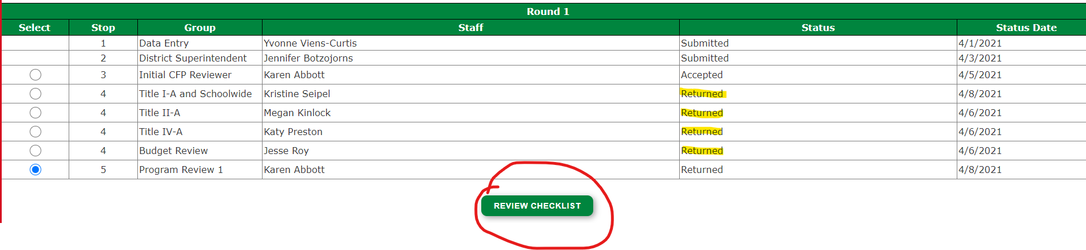
CFP Application Feedback LEA Review Process: Step 2
On Review Summary page, select Stop 5 for program review & click Review Checklist
Notes:
Review Summary page lists all people who have reviewed and status of that portion of the CFP application. You can double check which program section need to be reviewed by confirming the status has been returned here.

Slide 26
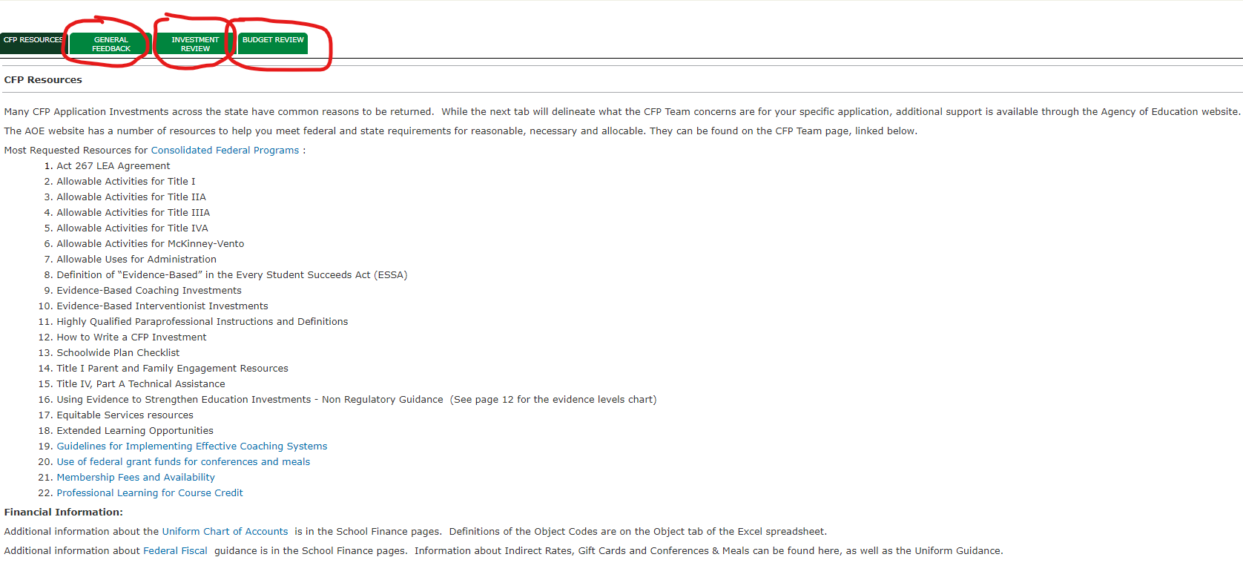
CFP Application Feedback LEA Review Process: Step 3
The Review Checklist page should appear, with 4 tabs
Notes:
The first tab CFP Resources is for informational purposes only and can be skipped over.

Slide 27
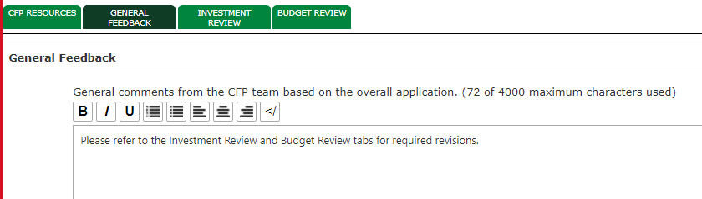
CFP Application Feedback LEA Review Process: Step 4
General Feedback Tab
Notes:
The second tab “general feedback” should be clicked on first as this is where you will be directed to which of the remaining tabs need to be reviewed.

Slide 28
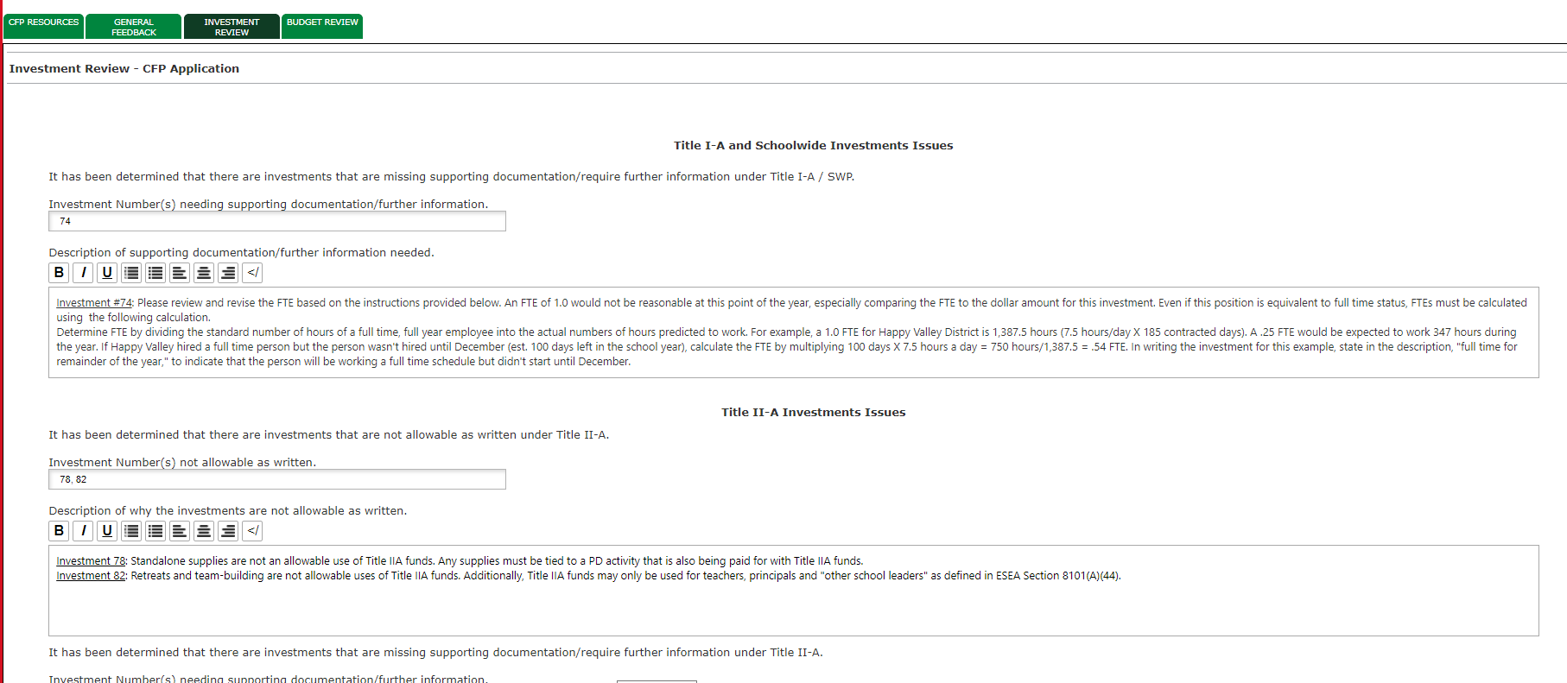
CFP Application Feedback LEA Review Process: Step 5
Investment Review Tab
Notes:
This is where all programmatic specific feedback will be outlined, so make a to do list or checklist for yourself when reviewing the feedback on this tab to ensure all feedback listed here is addressed when you re-submit.

Slide 29
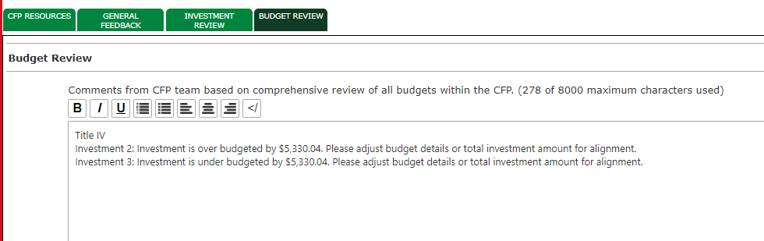
CFP Application Feedback LEA Review Process: Step 6
Budget Review Tab

Slide 30
Roadmap to Application Feedback Checklist
Complete LEA Review Process Steps 1-6
Create To Do List or Checklist for all Investment and Budget areas needing Revisions & confirm that all feedback listed has been addressed
Review needed changes with Business Manager & confirm codes
Reach out to dedicated AOE program staff for clarification or feedback questions as needed (prior to submission)
Double Check you have saved (scroll to top of page to confirm no error message in red) & submit

Slide 31
Program Specific AOE Staff Emails
Name | Title | Email
Jesse Roy | Assistant Division Director, FESP | Jesse.Roy@vermont.gov
Karen Abbott | CFP Grant Programs Manager | Karen.Abbott@vermont.gov
Kristine Seipel | State Title I Director | Kristine.Seipel@vermont.gov
Katy Preston | Title IV Director and State Coordinator for Homeless Education | Katy.Preston@vermont.gov
Megan Kinlock | Title II & Migrant Education Director | Megan.Kinlock@vermont.gov
James McCobb | Title III/EL Program Director | James.McCobb@vermont.gov
Amber Graves | Title I Education Consultant | Amber.Graves@vermont.gov

Slide 32
Helpful Tips & Efficiency Suggestions
Make sure all Title budgets have a zero balance remaining
FTE needs to match remaining time in the year (instructions on investment upload page for calculation)
Make sure to review all changes with your business manager prior to submission to verify object and function codes (this helps avoid disallowed costs)

Slide 33

Questions?

