Slide 1
What is a CFP Team Leader?
CFP 101 Training
October 21, 2021
Notes:
Good Morning, my name is Karen Abbott and I serve as the CFP Grant Programs Manager. We are excited to have you all here today and look forward to working with you in the future.

Slide 2
Agenda Overview
9:00 – 9:50 What is a CFP Team Leader?
10:00 – 10:50 Title I Overview
11:00 – 11:50 Title II Overview
11:50 – 12:30 Lunch
12:30 – 1:20 Title IV Overview
1:30 – 2:30 A Walk-through the CFP Application

Slide 3
Roles and Responsibilities

Slide 4
Communication, Coordination and Documentation are the keys to CFP success
CFP Team Leader
Business Office
Data Manager
Parents
AOE Staff
USDOE
LEA Leaders
School Staff
Community Partners
Notes:
Admin errors as a result of the 1st year system will be disallowed this year.
Make sure the codes are correct and the business manager reviews before submission
FY20 the GMS will have a business manager sign off

Slide 5
Communication is Key
To and from parents, community, school and LEA leaders
Resources, needs, planning, implementation, effectiveness
To and from the business office
Budgeting, procurement, spending
To and from the district’s data manager
Data submissions that effect CFP Funds
To and from the AOE and DOE
Rules, requirements, clarification, feedback
Notes:
Disseminate annual school and LEA report cards, or provide a link to the Annual Snapshot, by December of the following school year
Provide parents information about or access to their child’s individual levels of achievement on State academic assessments
Notification of the right to “opt out” of Federal, State or local assessments
Title III: “Implement an effective means of outreach to parents of English Learners…”
Homeless: “Parents or guardians of homeless students are informed of the educational and related opportunities available…[and] all transportation services…”

Slide 6
ESSA and Federal Guidance Documents
Every Student Succeeds Act
Non-Regulatory Guidance Documents:
Title I Schoolwide Programs
Title II
Title III
Title IV
Equitable Services
Supplement Not Supplant
Homeless Education
Targeting & Ranking

Slide 7
CFP Assurances
Distribute a copy of the CFP assurances to all administrators in the LEA by September.
Remember it is your responsibility for knowing what you’ve committed to.
Make sure to keep all documentation that relates to the assurances. You may be asked to provide this information during a CFP Onsite or Focus Monitoring.

Slide 8
CFP Timeline
These are best case scenarios deadlines
The timeline includes 4 types of activities – Grants Management, Professional Development, Monitoring and Data Requests
In addition, it includes when you can expect information from us
A tool to help you plan for the upcoming year

Slide 9
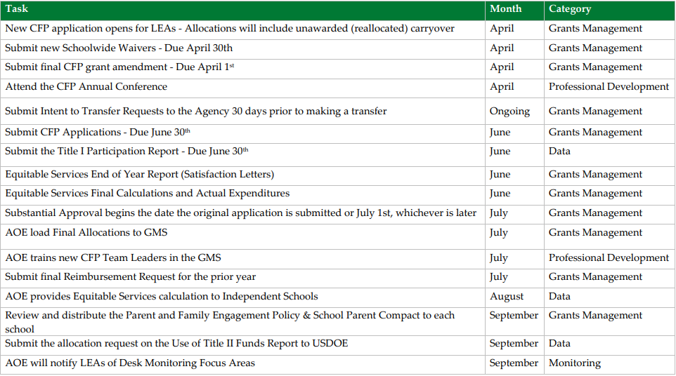
CFP Timeline

Slide 10
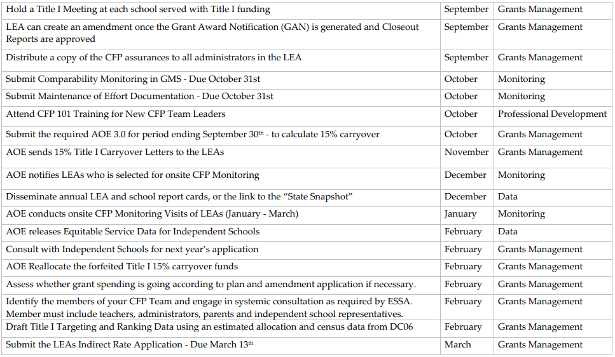
CFP Timeline

Slide 11
Supplement Not Supplant
Federal funds must be used to supplement (enhance, extend, increase) services, not supplant (replace) other sources of funding.
We will discuss the specifics of SnS within each Title in the today’s presentations.

Slide 12
Transfers
You may transfer up to 100% of the LEA’s Title II and/or Title IV Allocation to Title I, II, III, IV or V.
The LEA must submit Intent to Transfer Requests to the Agency 30 days prior to making a transfer.
Does not apply to consolidated funds such as SWP, Consolidated Admin, or REAP.

Slide 13
Grant Awards and Amendments
Grant Type | Examples | Period of Performance Starts
Federal Formula Grants | Title I, IIA, IV, IDEA, etc. | The later of either the date of substantial approval or July 1
Discretionary Federal Grants | 21C | the date the Secretary of Education signs the grant award
State Grants | Tobacco, Act 230, BEST | the date the Secretary of Education signs the grant award
Amendments | All Grant types and funding sources | the date the Secretary of Education signs the amended grant award

Slide 14
Monitoring
CFP Comprehensive Monitoring
Typically conducted onsite
All CFP areas are addressed
Focus Monitoring
Typically conducted as a desk audit
Areas of focus are based on technical assistance requested from the field and CFP assurances
Notes:
Two types of CFP Monitoring occurs each year

Slide 15
Equitable Services

Slide 16
Equitable Services
Federal law allows federal education aid to be provided to children in need, regardless of whether they attend a public or private school.
Private schools must be non-Profit, state accredited elementary and secondary schools

Slide 17
Equitable Services
Titles IIA, III and IVA: Independent schools/students within the boundaries of the LEA
Title IA: Independent schools, including those outside of the LEA, attended by students who reside in served areas of the LEA

Slide 18
Required Documentation
Written, signed affirmation of consultation with each independent school within the boundaries of your LEA
OR written affirmation of independent school choosing not to participate
OR documentation of attempts to consult
Written evaluation of the effectiveness of equitable services provided.
End of year satisfaction survey and summary of spending

Slide 19
LEA Control of Services
The LEA plans, designs, and implements program (including procurement)—this can not be delegated to the independent school.
Services must be provided by an employee of the district or a 3rd party contractor.
The LEA controls all funds, title to materials, equipment, and property purchased.

Slide 20
Equitable Services Quiz
Q: Do services for independent schools funded under these parts, including professional development, need to be the same as those funded for public schools?
A: No. Services are considered equitable if they meet the specific needs of eligible children and staff on a basis comparable to public school children.

Slide 21
Equitable Services Quiz
Q: May independent schools enter into contracts directly with third party providers or purchase materials to be reimbursed with equitable share funds?
A: No. Private school officials have no authority to obligate or receive federal funds. Equitable share funds must remain in the LEA’s control at all times. Additionally, the LEA is responsible for the planning, procurement, purchasing and implementation of all funded services.

Slide 22
Equitable Services Quiz
Q: What should be discussed and included in the signed documentation of timely and and meaningful consultation with independent schools?
A: How the needs of eligible private school children have been identified. What services the LEA will offer to eligible students. How, where and by whom the services will be provided. Satisfaction or concerns of independent school with consultation and proposed plan.

Slide 23
Equitable Services Quiz
Q: Are the students that generate the proportionate share of Title I Part A funds (students from low-income families) the only students that may access the equitable services provided in the non-public school?
A: No. Student eligibility for Title I, Part A services for private school children is determined by (1) residence in a participating public school attendance area, and (2) educational need. Poverty is not a criterion.

Slide 24
Fiscal Considerations

Slide 25
35% Flexibility
The AOE made a change in the methodology for calculating this budget flexibility for FY19 that will continue in FY22
the percentage is 35%
this is applied to the object code roll-up level not the grant award amount
The 35% flexibility is only applicable if the overspending is due to a budget estimating issue. A change in the “what” always requires an amendment.
You can never exceed the total grant award amount.
Notes:
In the past, the AOE has allowed subgrantees to overspend an investment line item up to 10% of the grant award amount (without an amendment) as long as the increase did not represent a change to the “what”
Remember, you can never exceed the total grant award amount, so if you use the flexibility to increase the amount in one investment you will need to be under in another investment.
The 35% flexibility resets upon amendment (for amended object roll-ups)

Slide 26
Example 1
Grant award budget is approved for a .5 FTE teacher at a cost of $35,000 for salary and $8,000 for benefits. When budgeted the LEA used a single person health plan to estimate the cost, but the person hired chooses a family plan at a cost of $10,000. The increase is under 35% of the object code roll-up for the same “what” - a .5FTE teacher.
*Example is simplified and assumes no other
benefits costs are rolled-up to the object code.

Slide 27
Example 2
Grant award budget is approved to send 2 teachers to a PD conference at an estimated cost of $1,000 each for a total of $2,000. Other spending of the grant award has been under budgeted amounts resulting in “available” grant dollars so the LEA decides to send 10 teachers for a total of $10,000.
The percentage over the original budget is irrelevant because the “what” has changed. The 35% flexibility does not apply and an amendment is required.

Slide 28
Subgrants
LEAs may only subgrant funds passed through the AOE to its member districts.
This is when the grant is received at the SU level, but obligations are incurred at a district level
Requires an official subgrant document signed by the Superintendent and Principal
The correct coding for funds that are subgranted is
Object Code 800
Function Code 5510
Notes:
Check yes on the investment page if a portion of the investment is subgranted to a member school district
In the budget detail, subgrants must be coded to object code 800
Object code 800 will not be excluded from indirect

Slide 29
Administration Caps for the Title Funds
Title I, Title II – 10%
Title III, IV, V – 2%
Admin caps include both direct and indirect administration
In the Con Admin budget all budget line items must be coded to Function Code 2495 (Administration of Grants)
Note: In the title specific budget(s) the LEA must use function code 9995 (Con Admin)

Slide 30
Indirect Costs on Amendments
Make sure to pay attention to your indirect costs during amendments
If you add dollars to your budget for direct costs please consider whether you can or want to add indirect dollars.
If you know that you are not going to be spending $ on an investment previously approved – reduce the investment as much you can.

Slide 31
Who Should I Contact?

Slide 32
CFP Application Contacts
NAME | Title | e-mail
Jessie Murray | Title I State Director | Jessie.Murray@vermont.gov
Amber Graves | Title I Consultant | amber.graves@vermont.gov
Megan Kinlock | Title II & Migrant Education State Director | megan.kinlock@vermont.gov
Jim McCobb | Title III State Director | james.mccobb@vermont.gov
Katy Preston | Title IV & Homeless Education State Director | katy.preston@vermont.gov
Karen Abbott | CFP Grant Programs Manager/CFP Team Lead | karen.abbott@vermont.gov

Slide 33
Questions and Answers

